Slide 1
Effectiveness when used Perimenopause

Slide 2
Problem
Not a lot known about the use of NFP/FABM during the peri-menopause transition.
During this transition the menstrual cycle length shortens but becomes more variable as menopause approaches.
It is like the reverse of the menstrual cycle variability with adolescents (Brown, 2011).

Slide 3
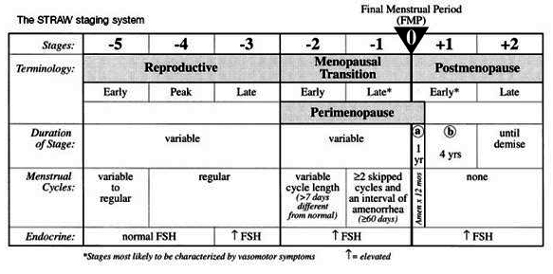
STRAW Model I

Slide 4
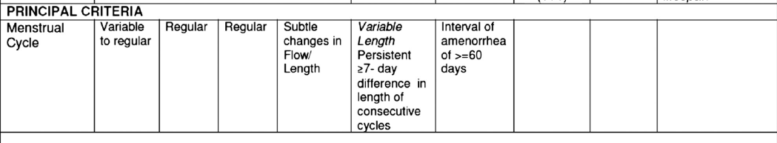
Parameters of the Menstrual Cycle by Age Group
GROUP 1) age 18-25 (N428 with =392 cycles of data), GROUP 2) age 26-34 (N=1,118, with 945 cycles of data), and GROUP 3) age 35-52 (N= 587 with 545 cycles of data)
Parameter Group 1 Group 2 Group 3
Mean/SD Mean/SD Mean/SD P level
Total length 29.5/4.00 29.5/3.61 28.3/3.15 < .001
Follicular phase 16.1/3.64 16.6/3.49 15.2/3.10 < .001
Luteal phase 13.1/2.37 12.8/1.92 13.0/1.87 < .001
Menses 5.3/1.66 5.3/1.26 5.0/1.43 < .001

Slide 5
Physiological Reasons for the
Peri-Menopause Transition
Depletion of follicles and eggs
Increased levels of FSH
Lower levels of AMH
Eggs (and sperm) are older with shortened and frayed chromosomes
The estrogen LOOP phenomenon

Slide 6
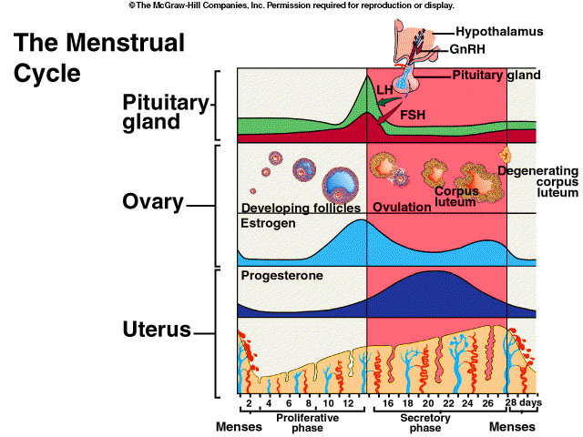
29
Notes:
Figure Two – shows a more detailed representation of the reproductive physiological dynamics. This figure shows the egg in the developing in a follicle and the release of the egg at ovulation. One of the hormones that stimulate the release of the egg is LH – which surges or peaks about 24 hours before ovulation. This figure also shows the rising level of estrogen that signals the beginning of the fertile phase. So if you can self measure the rising level of estrogen and the LH surge – you have good hormonal estimates of the fertile phase. However, a concern will be the accuracy and ease of use with using these markers by the woman to estimate fertility.

Slide 7
Background Studies
Israeli study with orthodox women found .2% pregnancy rate (Laufer, et al. Fertility & Sterility, 2004;81:1328-1332)
Flynn study (1991) 33% of women (between 45 and 53) were potentially fertile, 61% of the 177 menstrual cycles charted were potentially fertile (AJ of Ob/Gyn. 165(1991)1987-1989.
Metcalf (1979) – 50% of menstrual cycles are potentially ovulatory (JBiosocial Sc. 11:39-48).

Slide 8
WHO Review
50% of women over 40 are potentially fertile;
Risk of pregnancy for women 40-44 is about 10%, 2% for women 45-49, and not zero for women over the age of 50.
“Irregular menses and amenorrhea make the use of (FABM) impractical.”
WHO Scientific Group on Research on the Menopause in the 1990s (Geneva. Switzerland 1994)

Slide 9
Purpose
In reviewing the literature, however, there are no studies on the efficacy of NFP/FABM among peri-menopausal women.
Therefore, the purpose of this study was to determine the efficacy of using NFP/FABM to avoid pregnancy among women 40 to 55 years of age.

Slide 10
Methods
Retrospective analysis of existing data
All women sought and taught NFP/FABM at Marquette University
Older FAB method and new MM
150 women 40 yrs or older with ovulatory cycles
12 month unintended pregnancy rate
Use of survival analysis- Kaplan-Meier

Slide 11
Results – Demographics (N = 150)
Age: Mean = 41.7, SD = 2.5
Range = 40-54
Years Married: Mean = 13.6, SD = 6.9
Range = 1 – 32
Children: Mean = 4.3, SD = 1.9
Range = 1 – 9
73% Catholic; 54% White/24% Hispanic

Slide 12
Results: Pregnancy Rates
Total Pregnancies = 4.
Correct Use Pregnancies = 1; 98% survival at 12 months of use.
Typical Survival rate = .94 or 6 pregnancies per 100 users over 12 months of use.
The one unintended pregnancy was 40 year old women with first post partum cycle.

Slide 13
Conclusion
NFP/FABM use among older women can be very effective.
The high efficacy could be a reflection of diminished fertility among older women.
High efficacy could also be a reflection of higher motivation to avoid pregnancy.
Need more participants 40 and older.

Slide 14
Evidence Grades for NFP
Grades
MDM RJF
B C
Preventing pregnancy in premenopausal women

Slide 15
Effectiveness in atypical situations
Can I use NFP after stopping the pill?

Slide 16
Menstrual Cycle Characteristics after Discontinuation of Oral Contraceptives
Retrospective analysis of 70 women stopping OC’s vs. 70 age matched no-OC users
All new to Creighton model
Nassaralla et al. (2011) J. Women Health 20(2):169

Slide 17
Menstrual Cycle Characteristics after Discontinuation of Oral Contraceptives
Recent OC users had:
Sig. lower mucus quality scores, 1st 2 cycles
Later EDO
Lighter menses, 1st 4 cycles
“Menstrual cycle biomarkers significantly different 1st 6 cycles combined”
Confidence & Satisfaction with CrMs no different for women or men.
Nassaralla et al. (2011)

Slide 18
Use of STM- post hormonal contraceptives
175 women discontinuing OC’s (3048 cycles)
  Prior OC use mean= 3.5yrs (range 1-13yrs)
  Mean age 26.2 yrs.
  OC formulations used
    74% fixed combo EE= 30-37 µg
    6% fixed combo EE= 20 µg
    2% fixed combo EE=50 µg
    18% other combos & POP
284 matched women using STM (6251 cycles)
      Gnoth et al Gynecol Endo. 2002; 16:307

Slide 19
Characteristics of post-pill cycles
First post-pill cycle:
  51% normal
  49% had major disturbance
    32% short luteal phase (<10day)
    10% no temp shift
    7% long cycle w/ normal luteal phase
Compared to STM cohort, post-pill cycles:
  Significantly longer for 9 cycles
  Sig. more anovulatory cycles for 3 cycles
  Delayed mucus Peak Day for 6-7 cycles
  Delayed first day of temp rise for 6-7 cycles

Slide 20
Women can use STM Immediately after Discontinuing OC’s
Post pill Control
ID mucus peak -cycle #1 84% 90%
ID mucus peak -cycle #3 95% 96%
Unintended pregnancy rate 1.63 1.70
      Gnoth et al Gynecol Endo. 2002; 16:307

Slide 21
Evidence Grades for NFP
Preventing pregnancy in women immediately after stopping hormonal contraceptives
Grades
MDM RJF
B+ B+

Slide 22
Effectiveness in atypical situations
How effective is NFP with short or long cycles?

Slide 23
Use of NFP in Short / Long Cycles
Major efficacy trials excluded women with consistently short/long cycles
How many women fall outside the typical range?

Slide 24
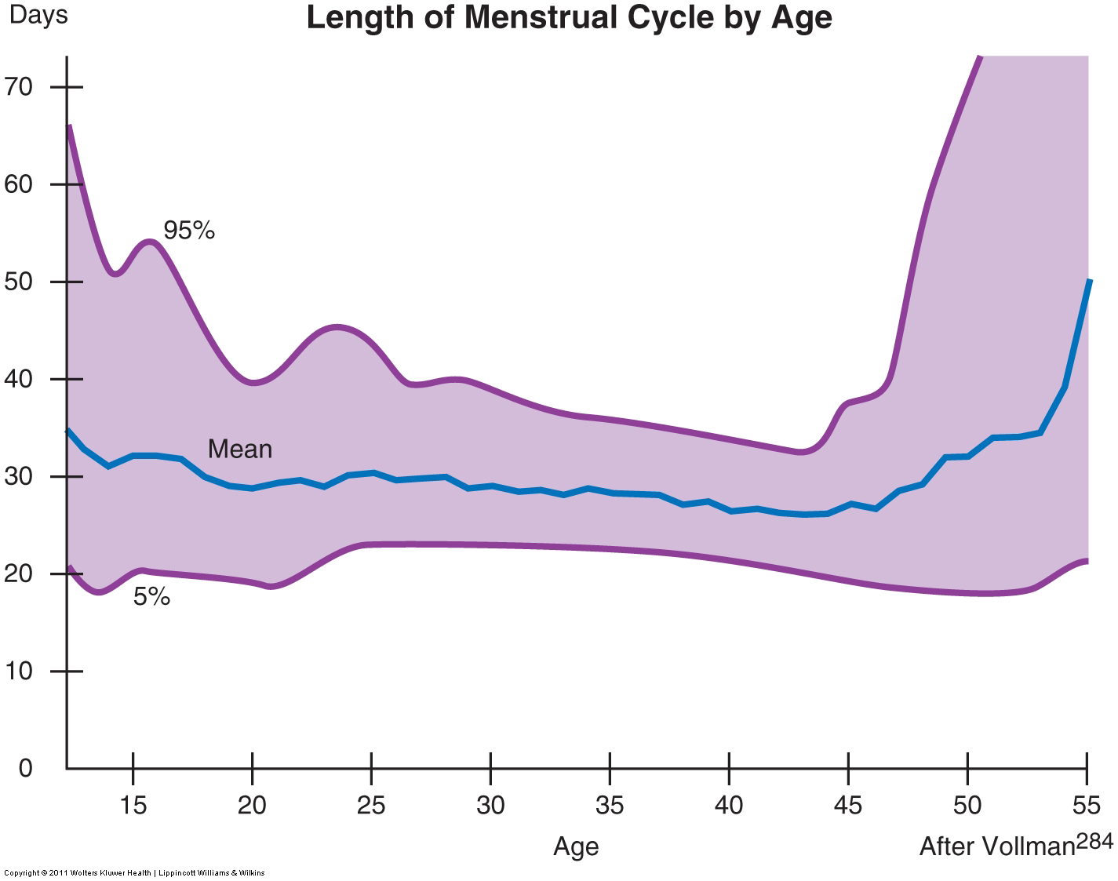
Cycle Variability by Age
Teenagers and premenopausal see long cycles more often
Very few with short cycles
From: Fritz & Speroff Clin. Gynecol. Endo. and Infertility 8th ed. (2011) p.241

Slide 25
Cycle variability- Danish population
Consistently short or long cycles very rare:
  0.5% - usual cycles lengths <21days
  0.9% - usual cycle lengths >35days
But an occasional odd cycle is common
  19% of women -at least 1 cycle <21days
  29% of all women -at least 1 cycle >35 days
Munster, Br J Ob Gyn 99(5):422 (1992)

Slide 26
Cycle Variability- US sample
95% of cycles between 22-36 days long
95% of cycles- 6 day fertile window between days 4-23
  25% of cycles with all 6 days between 10-17
Intracycle variability >7days in 42% of women
Fehring, Schneider, Raviele JOGNN 2006

Slide 27
NFP in variable cycles
Little hard evidence of effectiveness
Long cycles more likely than a very short one
Underlying Biology suggests:
  Daily observation methods should effectively cope
  Calendar based methods may be challenged

Slide 28
Evidence Grades for NFP
Grades
MDM RJF
F F
F C
C C
Preventing pregnancy in women with consistently short cycles (<21days)
Preventing pregnancy in women with consistently long cycles (>35days)
Preventing pregnancy in women with the occasional long/ short cycle

Slide 29
Differences between Contraception and NFP

Slide 30
Satisfaction with Current Use of NFP In Comparison with Current Users of Contraception and Sterilization (In Percentages) Oddens, B.J., Contraception, 59 (1999): 277-286.
PILL STERIL NFP
(N=522) (N=136) (N=76)
Concern preg 2.7 1.9 13.6
Concern health Risks 71.3 7.2 0.0*
Easy to use 91.9 86.9 38.3
Satisfied 82.9 92.1 71.6
More Tense 5.5 6.5 21.5
More Irritable 13.0 7.2 5.1*
More Anxious 1.9 1.4 19.0
More Depressed 10.3 5.0 3.8*
Freq of Intercourse 23.3 28.1 7.6
More Spontaneity 38.8 37.4 11.4
More Pleasure 25.0 28.8 27.8*
Sex Drive Increased 8.4 19.0 21.5*

Slide 31
Comparison Studies of NFP and Contraception
Fehring, R., & Lawrence, D. (1994). Spiritual well-being, self-esteem and intimacy among couples using natural family planning. The Linacre Quarterly, 61(3), 18-29.
Fehring, R., Lawrence, D., & Sauvage, C. (1989). A comparison of self-esteem, spiritual well-being, and intimacy in couples using natural family planning with couples using oral contraceptives. International Review of Natural Family Planning, 13(3&4), 227-236.

Slide 32
Comparison of Psychological/Spiritual Variables Between NFP Couples (N=44 Couples & 88 Individuals) and Contraceptive Couples (N=44 Couples & 88 Individuals)
NFP CONTRA
M/SD M/SD T-TEST
Spiritual Well-Being 108.7/10.3 96.4/15.0 6.36***
Religious Well-Being 55.3/6.5 46.7/10.4 6.98***
Existential Well-Being 53.4/5.3 49.7/ 7.7 3.73**
Self-Esteem 84.2/12.0 78.1/17.3 2.70**
Sexual Intimacy 78.2/13.4 72.8/16.0 2.43**
Intellectual Intimacy 77.7/14.2 71.7/17.0 2.57**
Recreational Intimacy 72.8/13.5 68.3/15.0 2.09*
*** p < = 0.001; ** p < = 0.01; * p < = 0.05

Slide 33
Physical/Biological differences
Contraception
Fertility
  Medical problem
  Needs to be controlled
  Is suppressed
Medical Side effects
Can mask medical problems
Easy to use
NFP
Fertility
  A natural process
  Needs to be lived with
  Is monitored
No medical side effects
Helps identify medical problems
At times challenging to use
Fehring & Kurz (2002)
Notes:
Richard Fehring and William Kurz summarized much of the research on the social and pyschological attitudes of those who use NFP and those who use contraception. And created a set of phrases to contract the differences..
One group they clustered as physical biological differences……

Slide 34
Psychological Differences
Contraception
No need to understand
Communication- are you using?
Woman is the object
Role model: sterility
NFP
Understand fertility
Communication- are we fertile?
Woman is respected
Role model: fertility
Notes:
They had an group of psychological differences shown here

Slide 35
Spiritual Differences
Contraception
Act is conditional
God’s gift of fertility is to be controlled
God not invited
Separates what God has put together
Fosters a Culture of Death
NFP
Act is mutual self-gift
Fertility is a gift from God
Couples become co-creators with God
Maintains what God has put together
Fosters a Culture of Life
Notes:
And they even had spiritual differences noted….

Slide 36
NFP and Divorce

Slide 37
M. Wilson
Hypothesis: the divorce rate will be less likely among couples who used NFP
Catholic Women (21-44) in Wilson Survey (N = 505) and in the 1995 (NSFG) 21-44 (N- 10,471).
3% in the Wilson Survey were divorced and 15% of the NSFG Catholic women.
Comparison is like comparing apples and oranges! One group population based, the other not., self-selected.

Slide 38
2010 NSFG (1,502 Catholic Women)
(N = 105 ever use of NFP & Divorce)
______________________________________________
Method Odds Ratio 95% CI Significance
______________________________________________
Pill (OC) 1.05 0.76 – 1.45 < .742
Sterilized 2.41 1.82 -- 3.20 < .001
Rhythm 0.76 0.54 – 1.06 < .109
NFP 0.47 0.24 – 0.91 < .023
Church Attend 0.66 0.49 – 0.89 < .007
Ever use of NFP 9.5% Divorced; Never use 18.3% Divorced.

Slide 39
Influence of NFP
Logistic regression: predictor variables 1) sterilized 2) abortion 3) multiple sex partners, 4) cohabitated, 5) NFP use, 6) importance of religion, and 7) church attendance.
Dependent variable: divorce or not
R = 45% (R square = 2%)
NFP, Church Attendance, and Steril – were significant.

Slide 40
Evidence Grades for NFP
Grades
MDM RJF
F F
NFP users divorce less frequently than couples using contraception

Slide 41
Which Method should I Recommend?
Two-Day Method
Creighton Model
Standard Days Method
Marquette Model
Billings Ovulation Method
Sympto-Thermal Method
Lactational Amenorrhea Method

Slide 42

Is There A Best Method?
The best method is..
“The method that works best for the couple”
How to choose?
Consider:
  Couple’s needs
  Characteristics of the
    different methods
Notes:
Add example to notes

Slide 43
Couple’s Needs
Availability of qualified instructor?
Comfort with On-line learning?
Time/ “ability” to learn?
Comfort with “medical vs. non-medical” approach?
Offers a double check?
Affordability (initial & ongoing)?
Special circumstances?
  Postpartum
  Premenopausal
  breastfeeding
Irregular sleep schedules?
Irregular Cycles?
History of infertility?

Slide 44
Characteristics of Methods
Calendar based
  Standard Days (Cycle Beads)
Mucus-only methods
  Billings
  Creighton Model
  Two Day Method
Sympto-Thermal
  CCL (Couple to Couple)
  Northwest Family Services
  Serena
  Various diocesan-based programs
  TCOYF (Toni Weschler) and others
Sympto-Hormonal
  Marquette
Hormonal
  Marquette

Slide 45
Fertility Signs Employed
Good clinical evidence
  External cervical mucus (numerous grading scales)
  Basal body temp
  Calendar based rules
  Urinary hormonal metabolites
  Lactational amenorrhea
Poor/ missing clinical evidence
  Internal mucus observations
  Cervix
  Salivary electrolytes
  Ferning patterns

Slide 46
NFP is too Complicated to Use

Slide 47
NFP too complicated?

Slide 48
Overall Problem
Only 0.1% of US women use modern methods of natural family planning.
Women (and men) want safe, effective, easy to use, and convenient methods of family planning.
Although NFP methods are free of side effects, they are often ineffective and complex to learn and use.

Slide 49
Thesis
One reason that NFP methods are not used more – are that they are not that effective – i.e., 20-25 pregnancies per 100 women (Trussell, 2011).
Another reason is that they are not easy to use or to provide.

Slide 50
Comparison of fertile phase
28 days
26 days
17 days
12 days
6 days

Slide 51
Cervical Mucus - Columbo
Colombo – 1999, 2003
Average cervical mucus days = 17 days
Missed mucus peak 17%
Master NFP teacher correlation = 60%
Notes:
This evidence has been confirmed by Italian researchers who discovered with a large data set with Italian users of the ovulation method (i.e., cervical mucus only) that the fertile phase as estimated by cervical mucus to be approximately 17 days in length (Columbo, 1999, 2004). Furthermore, when master teachers of the methods retrospectively estimated the days of fertility the correlation was only 60% --- yet we expect women to prospectively estimate fertility with the same markers – maybe cervical mucus monitoring is not so easy and maybe not so accurate.

Slide 52
Length of Fertility (N=1149)
CPEFM was 6.1 days (SD = 2.6)
Mucus was 11.1 days (SD = 5.8)
(t = 28.33, p < 0.000)
(r = 0.18, p < 0.000)
11.1
6.1
Notes:
The mean length of the fertile phase as determined by the first day of cervical mucus through 3 full days past the peak day of cervical mucus was 10.8 days (SD = 3.7). The mean length of the fertile phase as determined by the CPEFM was 6.7 days (SD = 3.1). There was a statistical difference between the mean length of fertility as determined by the two methods (t = 12.71, p < 0.001).

Slide 53
Efficient Use & Provision
Leo Latz, MD: 12 minute NFP method – calendar rhythm
Georgetown: Standard Days method – fixed calendar system
Georgetown: TwoDay mucus only method
Marquette Lite:12 minute NFP – CEFM plus formula

Slide 54
Efforts of Loyola, Georgetown, Heidelberg and Marquette University Researchers to Simplify NFP
Notes:
I will now describe some recent efforts to streamline NFP methods so that they are more user and provider friendly (while maintaining efficacy).

Slide 55
Latz’s Three Minute “Rhythm”
Shortest cycle minus 19 days
Subtract shortest from longest and add “8” days to that number
Example: 26 shortest and 30 longest
Rhythm is: 26 –19 = 7 and 4 + 8 = 19
Fertile window is from day 8 through day 19 = 12 days.
Notes:
He developed what he called the 3 minute rhythm – that a physician could easily teach a woman how to use in a short office visit!
It goes like this----
Please note that he estimated that the fertile window was about 7 days but added a day (8) as a precautionary or cushion of safety!
We now know from the research of Wilcox and others at the National Institute of Environmental Health Sciences – biostatistics branch that there is a 6 day window of fertility the day of ovulation and the 5 days before.

Slide 56
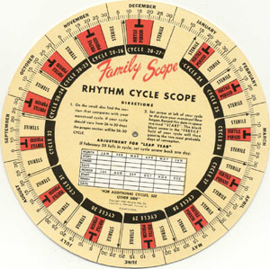
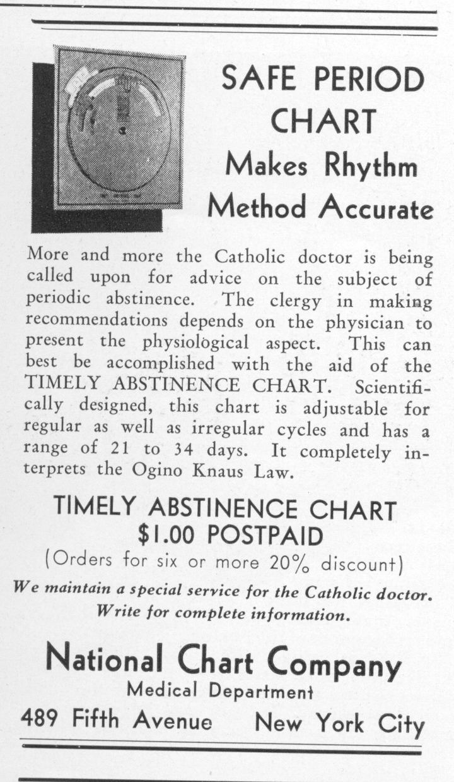
Ad in June, 1935 –
The Linacre Quarterly

Slide 57
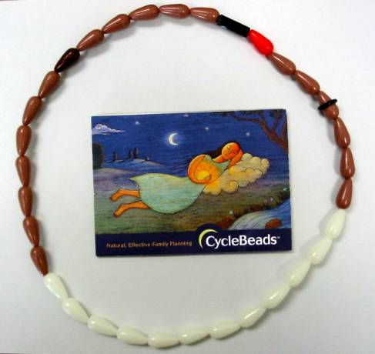
Standard Days Method (SDM)
Days 8 – 19 fertile
Cycle length 26 – 32
95% Correct Use
88% Typical Use
Arevalo M, Jenning V, Sinai I. Efficacy of a new method of family planning the Standard Days Method. Contraception 2002;65:333-338.
Notes:
Researchers at the Georgetown University Reproductive Institute have developed two simple methods of natural family planning.
One of the methods called the Standard Days Method or SDM involves the use of Cyclebeads to track the cycle and fertility.
The method is for women who have cycles between 26 and 32 days in length. The days of the cycle that are considered fertile are days 8 through day 19.
If a women has two cycles longer than 32 days or shorter than 26 days – they are advised to use another method of Natural Family Planning.
When used correctly the method is 95% correct use and 87% typical use in avoiding pregnancy.

Slide 58

Efficacy of the TwoDay Method
Did I note any secretions today?
Did I note any secretions yesterday?
Correct use = 96.5%
Typical = 86.3%
Arevalo, Jennings, et al., Efficacy of a new method of family planning. Fertil Steril, 2004: October Issue.
Notes:
The other new simple method developed at Georgetown University is called the TwoDay method.
This method involves the use of two questions;
Did I notice secretions today?
Did I notice secretions yesterday?
If the woman answers No to both then she can consider herself infertile.
A recent study showed that when used correctly it is over 96% effective in avoiding pregnancy.

Slide 59
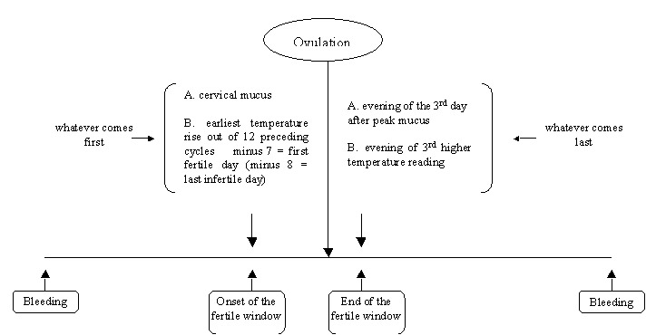
European Double Check
Notes:
European physicians and scientists took on the task of creating an efficient and accurate method of NFP for busy European women who wanted a secure natural method of birth control. They studied the various markers and rules of current methods and developed what they call the double check method of NFP or a double check symptom-thermal method. The double check for the beginning of the fertile phase is the presence of cervical mucus and or a calendar based formula, the end of the fertile phase is the peak in cervical mucus or the BBT temperature shift (whichever comes last). As mentioned a recent prospective efficacy study among 900 couples provided efficacy rates that rival the pill.

Slide 60
High Tech – 3 Minute Rhythm
TO AVOID PREGNANCY: Do not have intercourse during fertility
1. Fertility BEGINS on day 6 during the first 6 cycles; After 6 cycles of charting then,
2. Fertility BEGINS on the earliest day of PEAK during the last 6 cycles minus 6 days
3. Fertility ENDS on the last PEAK day plus THREE full days; After 6 cycles
4. Fertility ENDS on the last PEAK day of the last 6 cycles plus THREE full days
Notes:
Now I would like to teach you a 3 minute high tech algorithm for use of the Clearplan monitor!
The parameters of the cycle are from 21 days through 42 days in length.
The woman should between the ages of 18 and 42 days.

Slide 61
Rebecca Peck MD
12 Minute office session to teach NFP.
http://www.youtube.com/watch?v=qj5k90OnbFg

Slide 62
Medical Applications
Menstrual Cycle as a Vital sign
Use of NFP with sub-fertility
Use of NFP with dysfunctional bleeding
Use of NFP to monitor Tx of PCOS
Use of NFP to time medications and tests.

Slide 63
NaProTechnology
J.B. Stanford, T.A. Parnell, and P.C. Boyle, “Outcomes from treatment of infertility with natural procreative technology in an Irish general practice,” Journal of the American Board of Family Medicine 2008;21:375-384.
Retrospective cohort study (N=1,234) infertility patients from one family medical practice in Ireland during the years 1999-2006. The gross live birth rate at twelve months of treatment was 27.6% and at twenty-four months 33.9%.
E. Tham, K. Schliep, and J. Stanford, “Natural procreative technology for infertility and recurrent miscarriage. Outcomes in a Canadian family practice,” Canadian Family Physician 58 (2012): e267-74.
Retrospective cohort of 99 couples with infertility and another 9 couples with recurrent miscarriage. Live births, the adjusted proportion at 12 months was 44.5 per 100 couples and at 24 months was 66.0 per 100 couples

Slide 64
RCT Study
S. Bhattacharya, K harrild, J Mollison, et al., “Clomifene citrate or unstimulated intrauterine insemination compared with expectant management for unexplained infertility: pragmatic randomized controlled trial,” British Medical Journal 2008;337:a716.
The scientists found that the live birth rates for the clomefine group (N=194) was 26/192 (14%), for the intrauterine insemination group (N=193) it was 43/191 (23%), and for the expectant management group (N=93) 32/193 (17%). There were no statistical differences among the three pregnancy rates of these three treatment groups.

Slide 65
Backup /Extras

Slide 66
Can I require NFP as part of Marriage Prep?

Slide 67
Common Concerns
No one will be happy
Not enough teachers
Too expensive/burdensome for the couples
The bishop will never mandate it
We won’t be able to teach everybody
Even if we teach them, they won’t use it

Slide 68
Required Dioceses
Dioceses requiring full NFP course:
      Denver Colorado Springs
      Fargo Cheyenne
      Phoenix St. Augustine
      Lexington Covington
      Richmond Little Rock
Compliance with diocesan policy: Poor to Good

Slide 69
Required NFP Classes-
Couples Feedback
Covington Experience 2009-present:
45% admit having a negative attitude before class
95% state they have a better understanding of their fertility
> 90% found taking the class beneficial
83% would recommend classes to a friend
  74% with a negative attitude would recommend

Slide 70
Common Concerns
No one will be happy
  experience shows otherwise
Not enough teachers
  True, but mandated policy brings more
  Alternative learning vehicles
  (Home course, online)
Too expensive for the couples
  $150-200 for lifetime skills vs. wedding costs
  Surprisingly few requests for financial aid

Slide 71
Common Concerns
The bishop won’t mandate it
  Arlington experience
  Focus on those who are interested
We won’t be able to teach everybody
  Focus on what you can do
Even if we teach them they won’t use it

Slide 72
How effective is an introduction to NFP?
Peoria- experience over 12+ yrs.
Full day (5.5hr) Christian Sexuality Workshop
7-10% of couples skip CSW go to Full NFP
CSW brings 3-8% more to full NFP class
  Even when diocese paid NFP instruction costs
Logistical/ resource effort for the diocese?

Slide 73
LAM- WHO trial
4118 breastfeeding women, 7 countries
3443 completed study
85 total pregnancies
  46 in B.F women not using contraception
 | Full Breast. |  | Partial B.F. |  | Weaned
Contraceptive use | No | Yes | No | Yes | No | Yes
# pregnant | 14* | 2 | 32 | 16 | 12 | 9
*13 from China center

Slide 74
Cycle Lengths in ‘Postponing’ Studies
Method | Study | Included cycle lengths, age
Billings | WHO multi country (1980) | 23-35 days
 | Indian Task force (1996) | 26-31 +5, 15-35yrs.
Standard Days | Arevalo (2002) | “most cycles 26-32 days” 18-39yrs.
STM | Frank Herman (2007) | 22-35days (20% deviation), 19-45yrs.
 | Frank Herman (1997) | No specific length, 19-45yr
Creighton | Hilgers (1998) | 43% -21-38 days, 5% -cycles usually>38days, 3%-over 40yrs
 | Howard & Stanford (1999) | 46% -21-38 days, 5% -cycles usually>38days, <2%-over 40yrs
Marquette | Fehring (2007) | 21-42 days
 | Fehring (2012) | 21-42 days 18-42 yrs.
Two Day | Arevalo (2004) | No specific length, 18-39 yrs.

