Slide 2
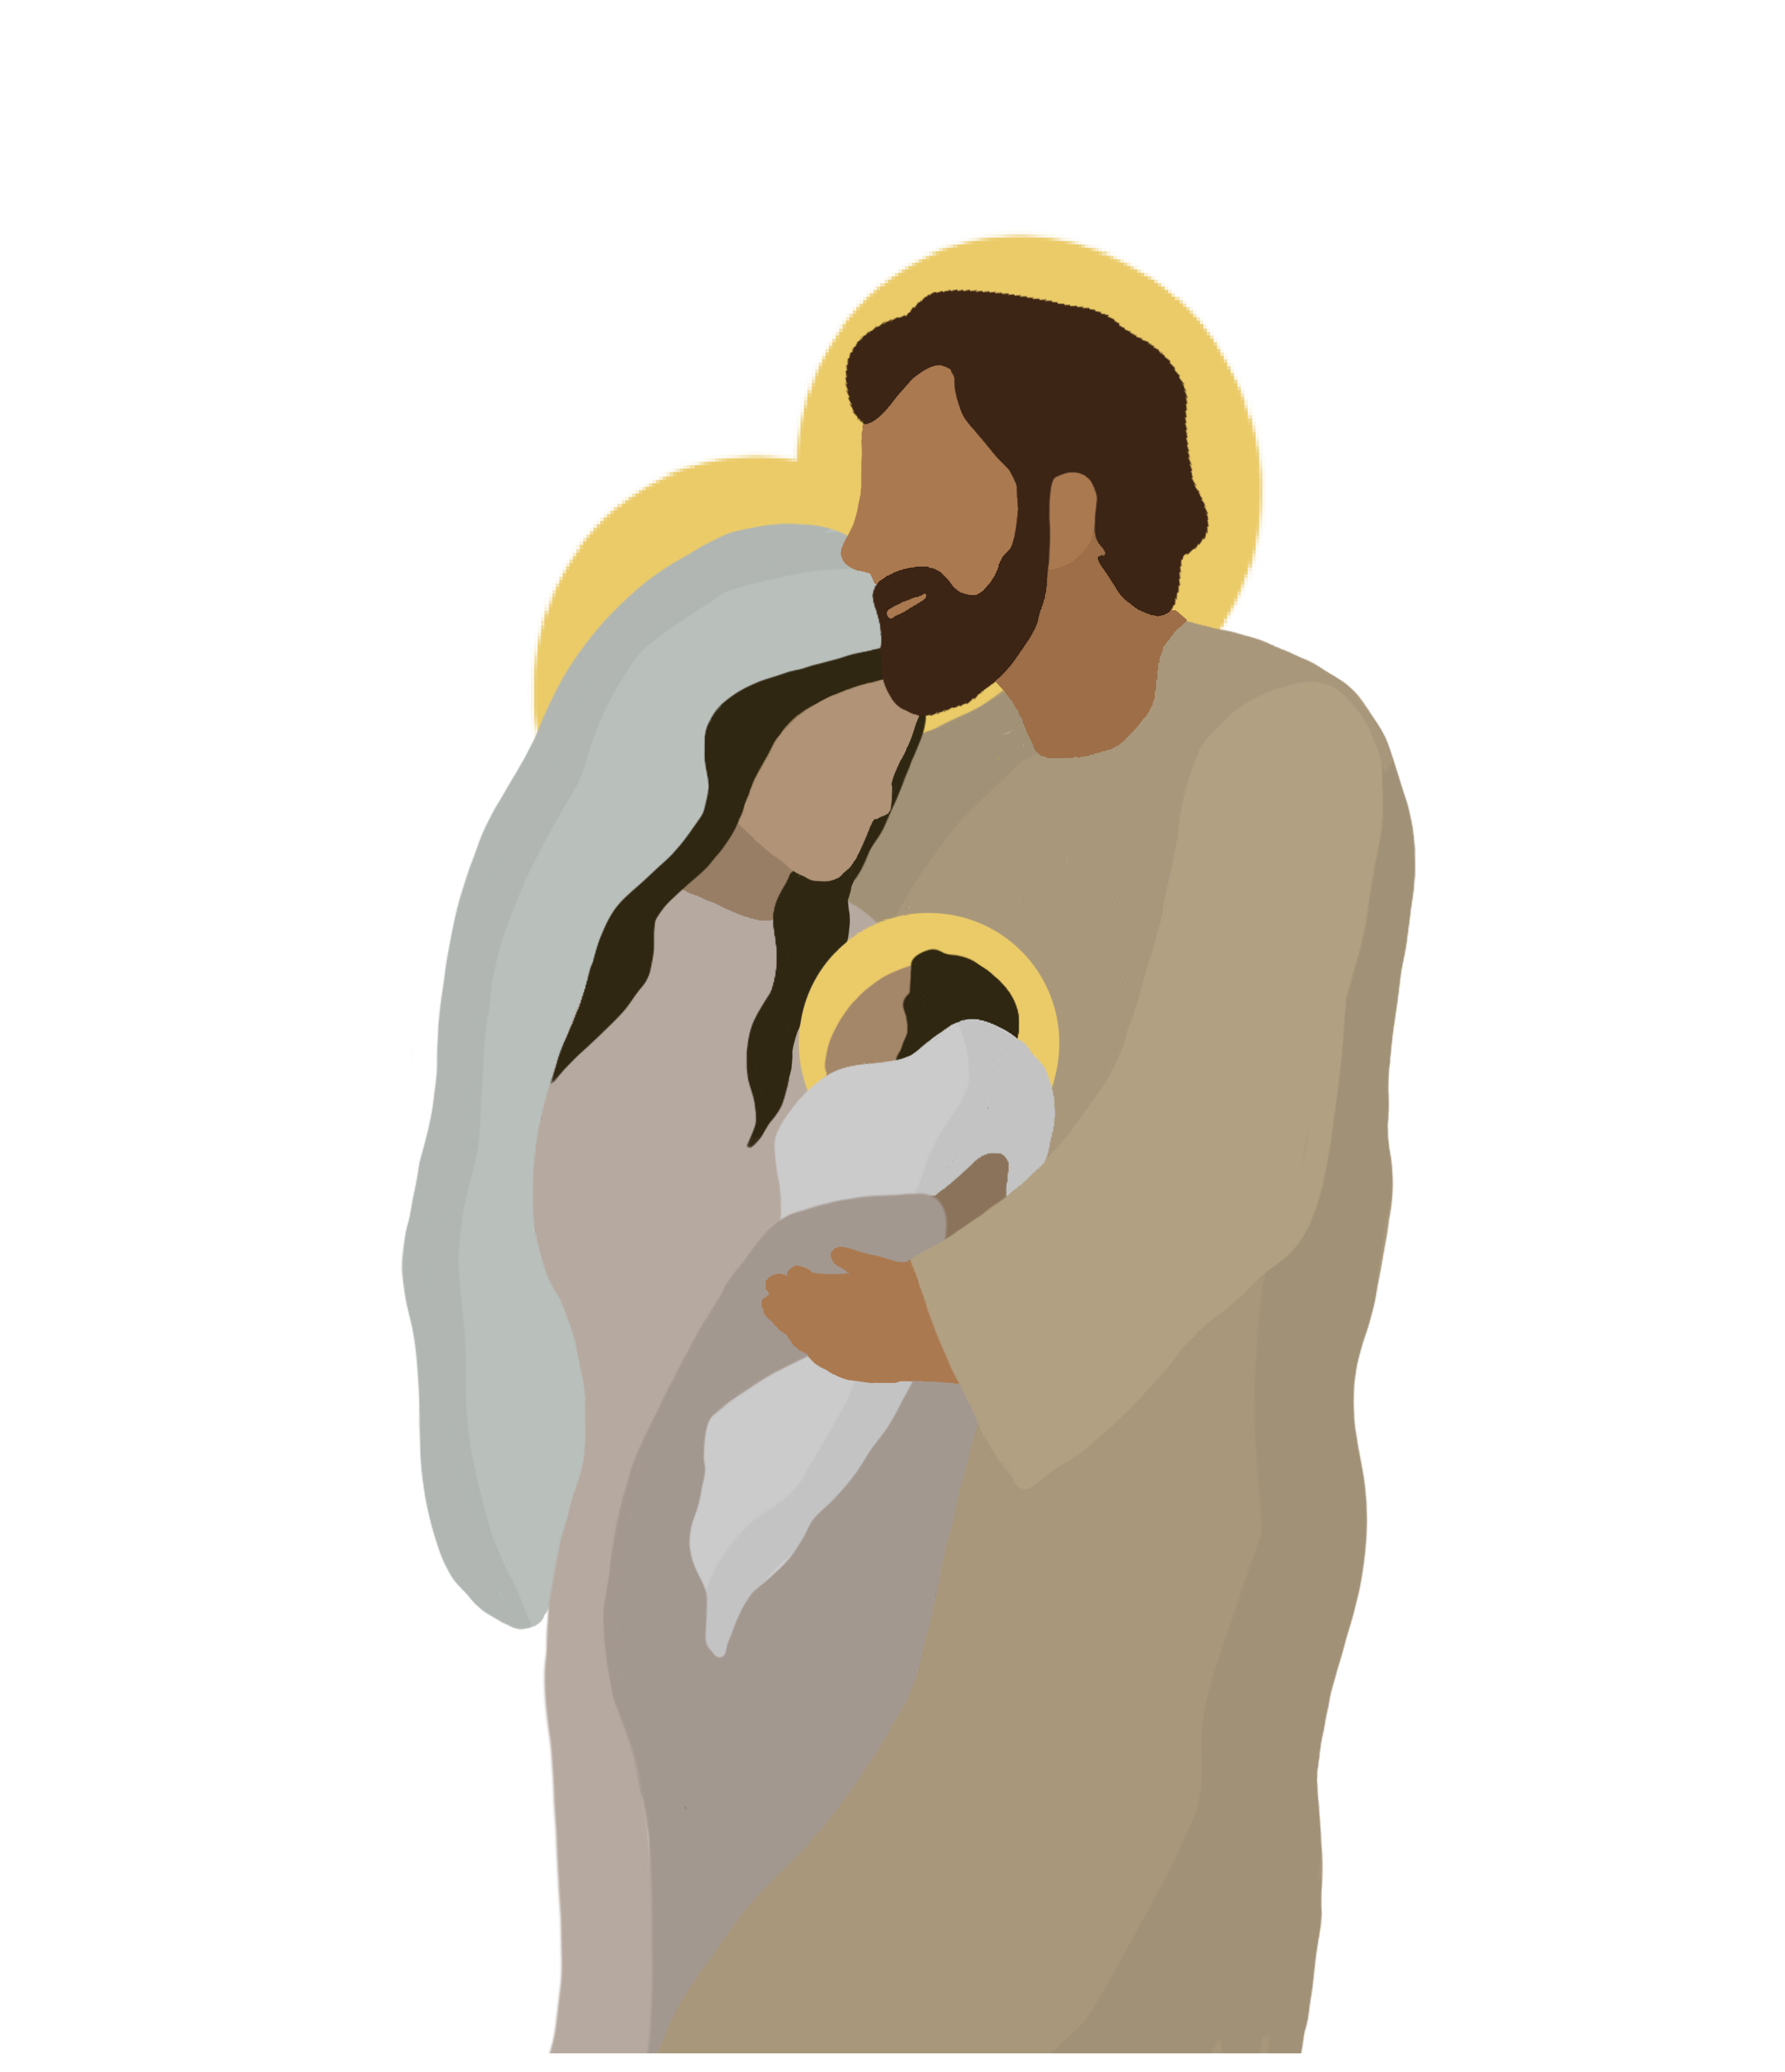
Dearest St. Joseph,
at the word of an angel,
you lovingly took Mary into your home.
As God’s humble servant, you guided
the Holy Family on the road to Bethlehem,
welcomed Jesus as your own son
in the shelter of a manger,
and fled far from your homeland
for the safety of both Mother and Child.
We praise God that as their faithful protector,
you never hesitated to sacrifice
for those entrusted to you.
May your example inspire us also
to welcome, cherish, and safeguard
God’s most precious gift of life.
Help us to faithfully commit ourselves
to the service and defense of human life
—especially where it is vulnerable or threatened.
Obtain for us the grace
to do the will of God in all things.
Amen.
Notes:
Can you see this note?

Slide 3
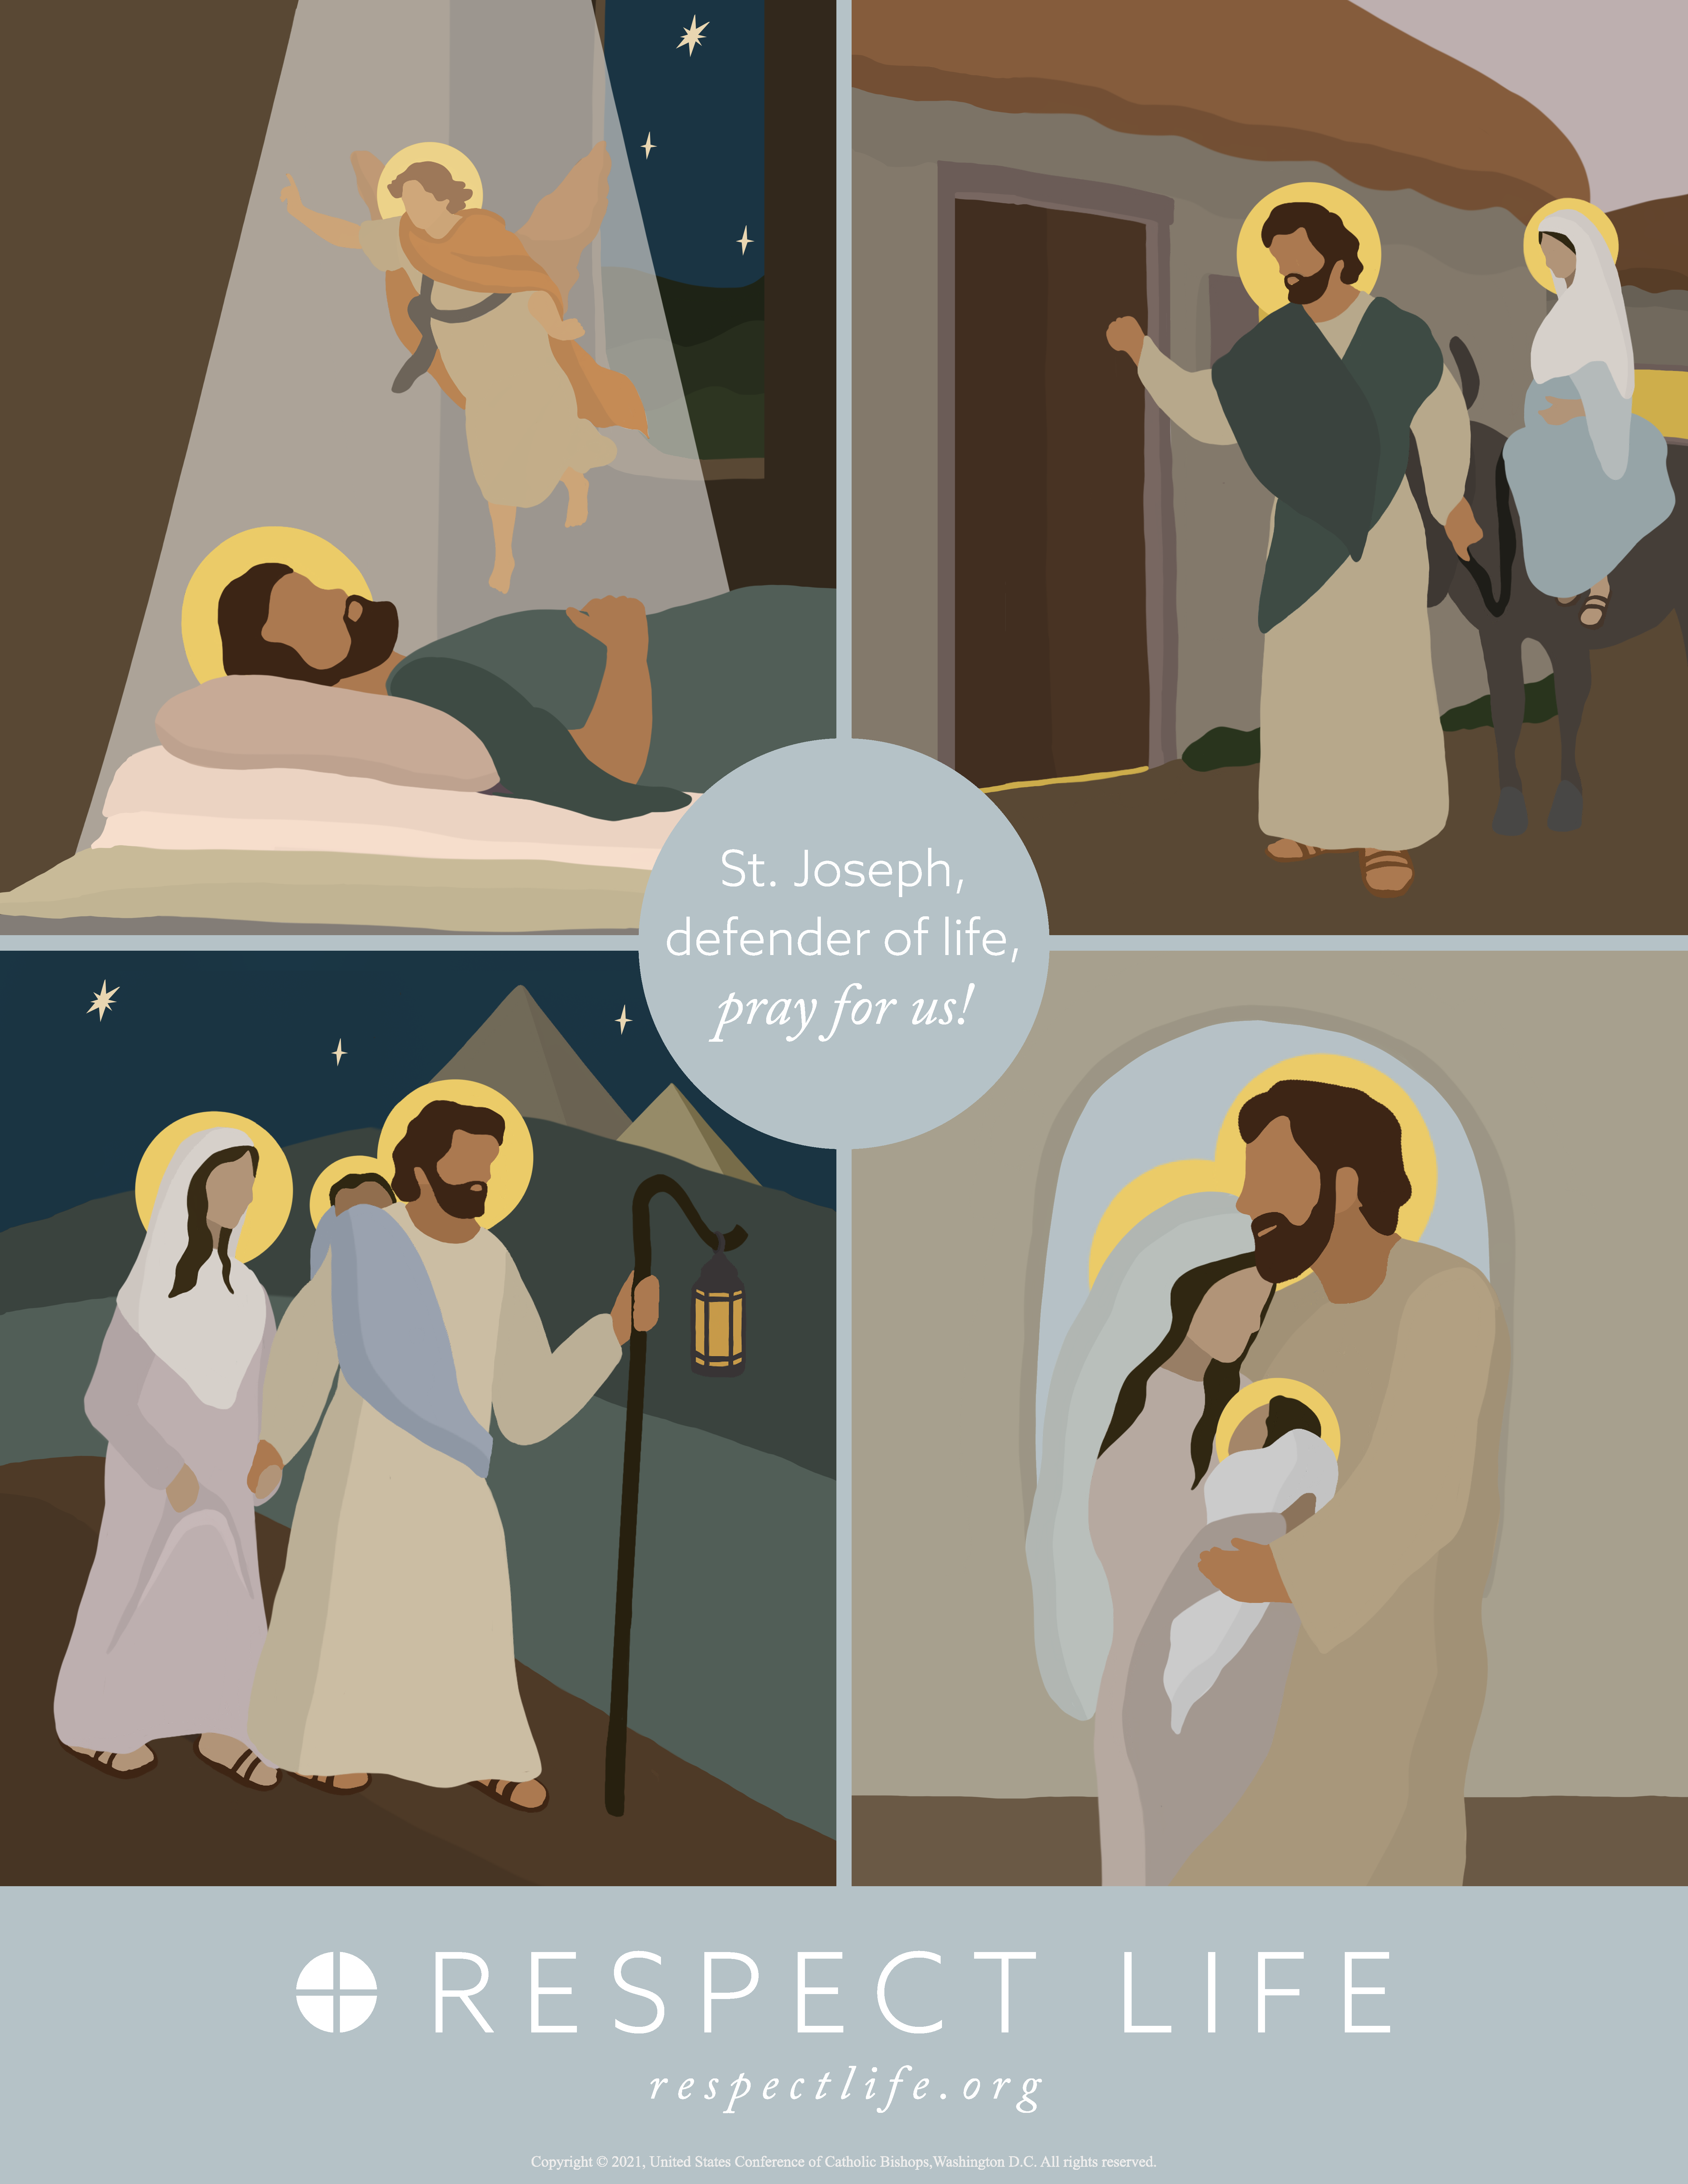
St. Joseph, Defender of Life, pray for us!

Slide 4
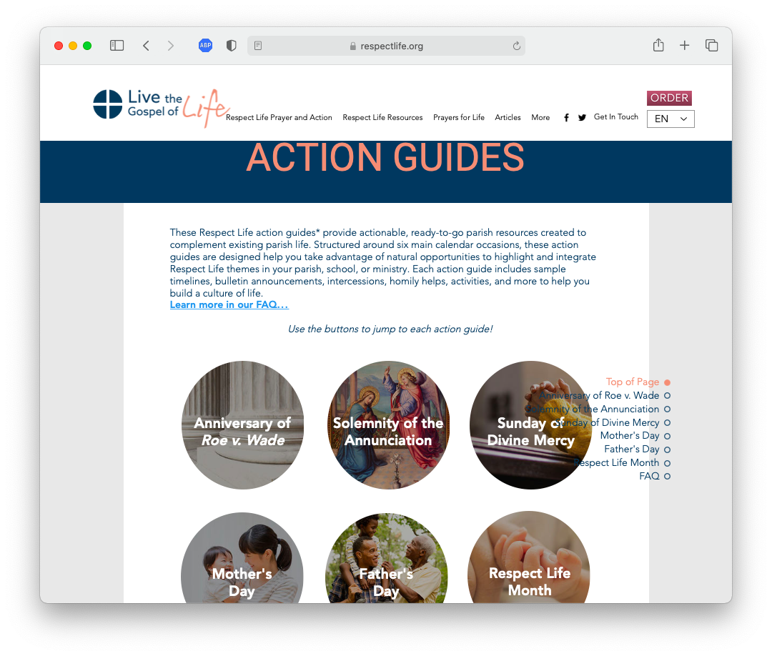
Where can I find the action guide?
respectlife.org/action-guides
FAQ
Respect Life Month Guide

Slide 5
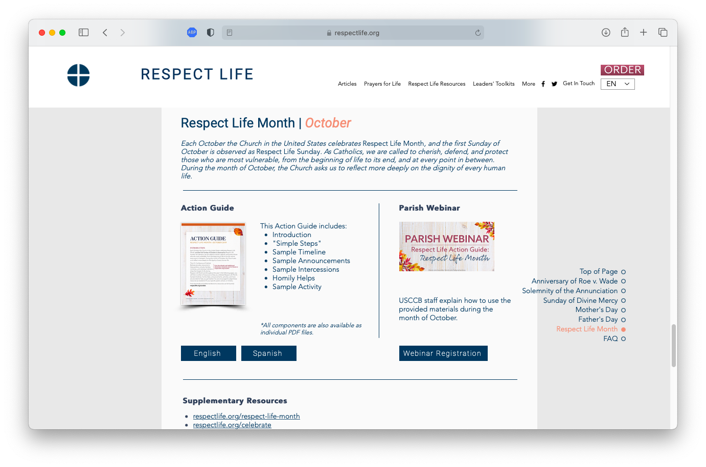
Where can I find the action guide?

Slide 6
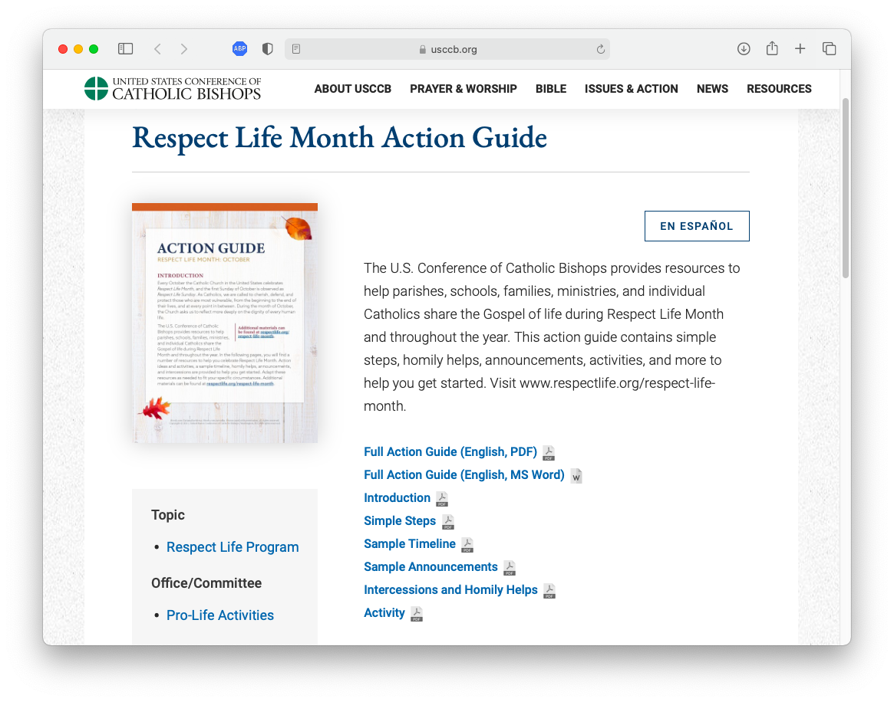
Action Guide Files
Full Action Guide
Components

Slide 7
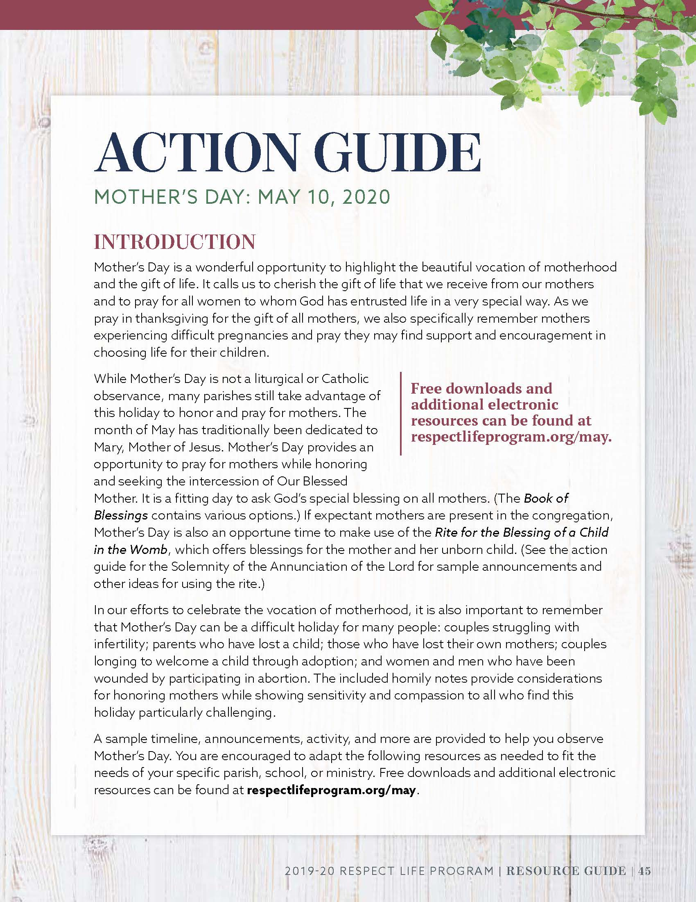
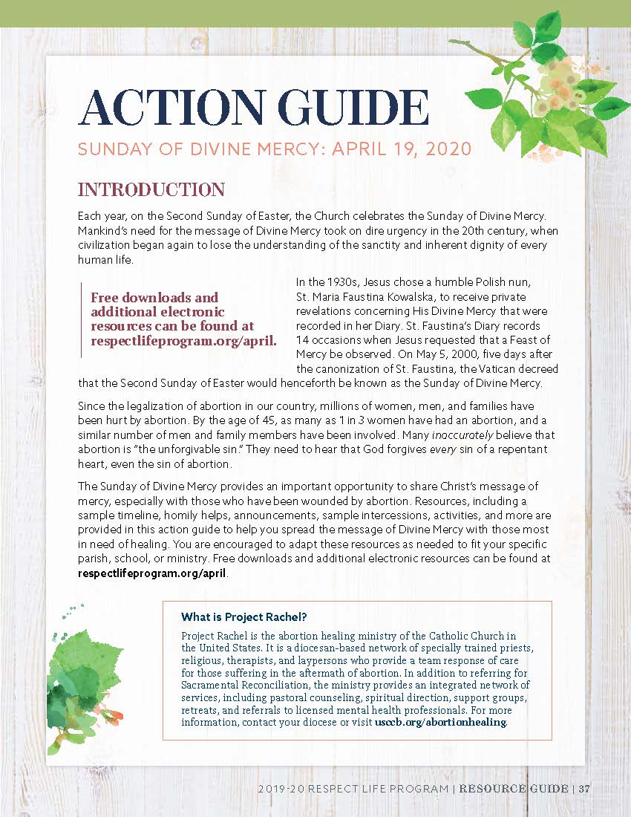
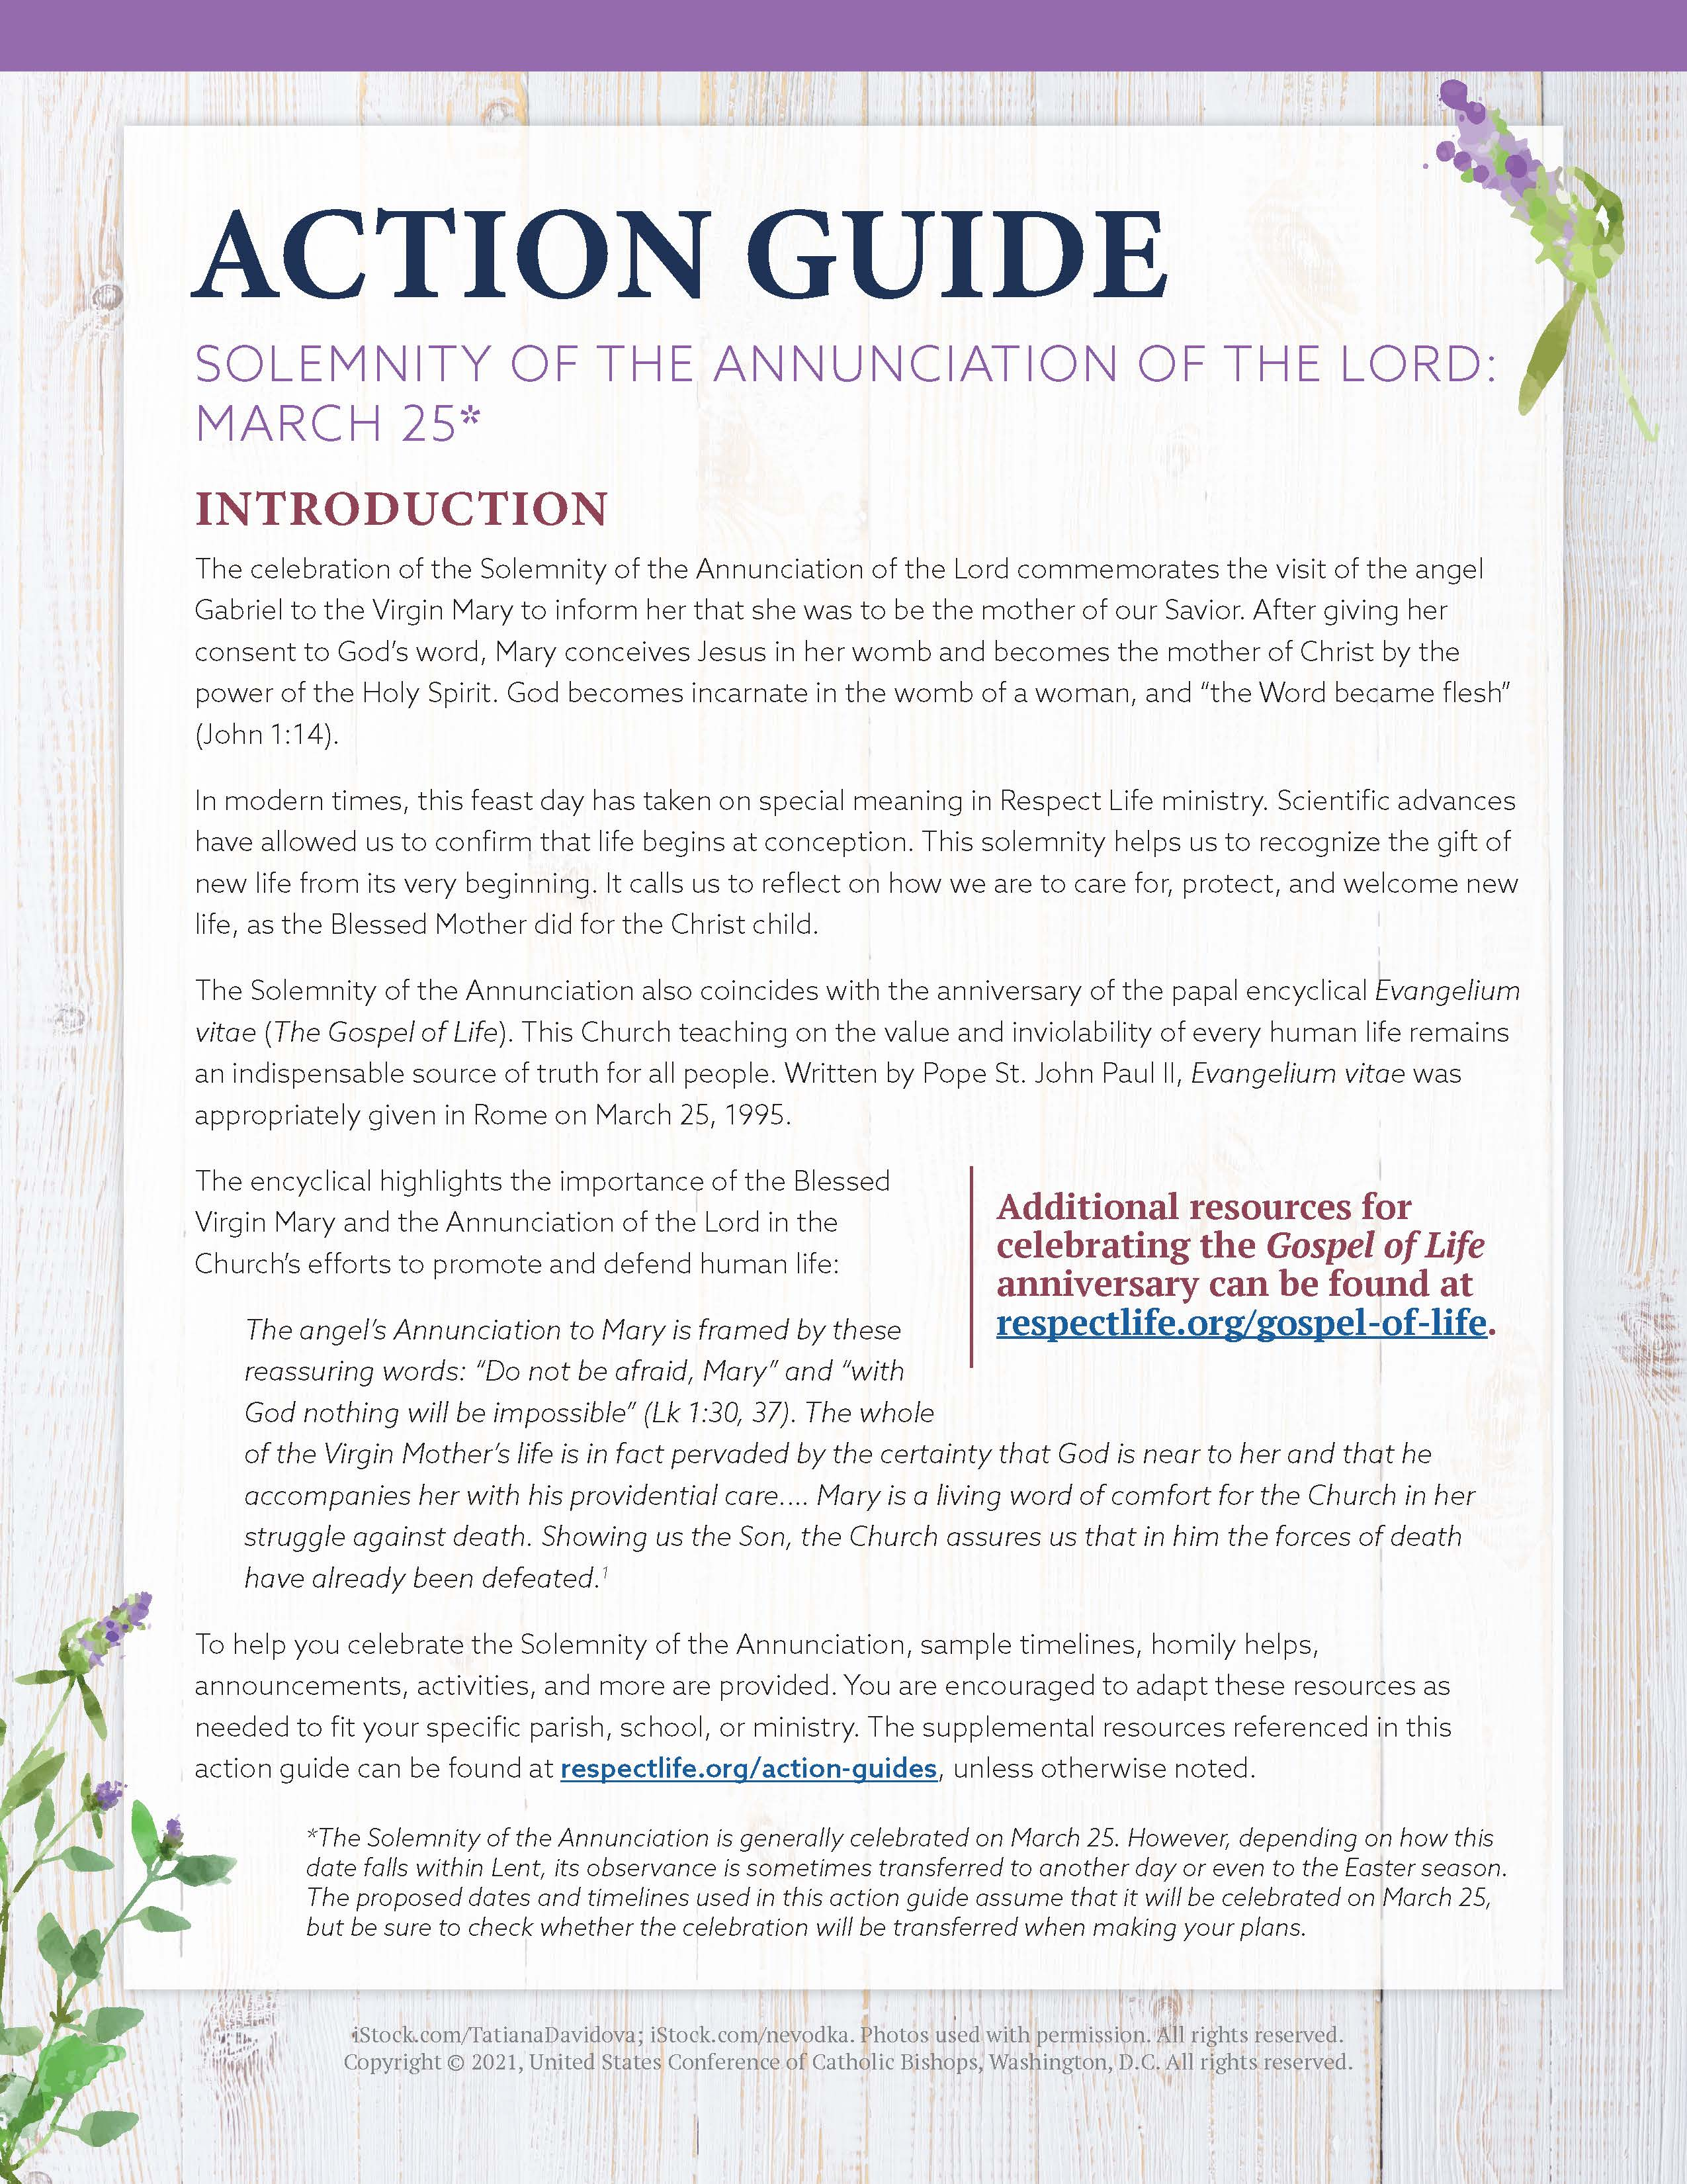
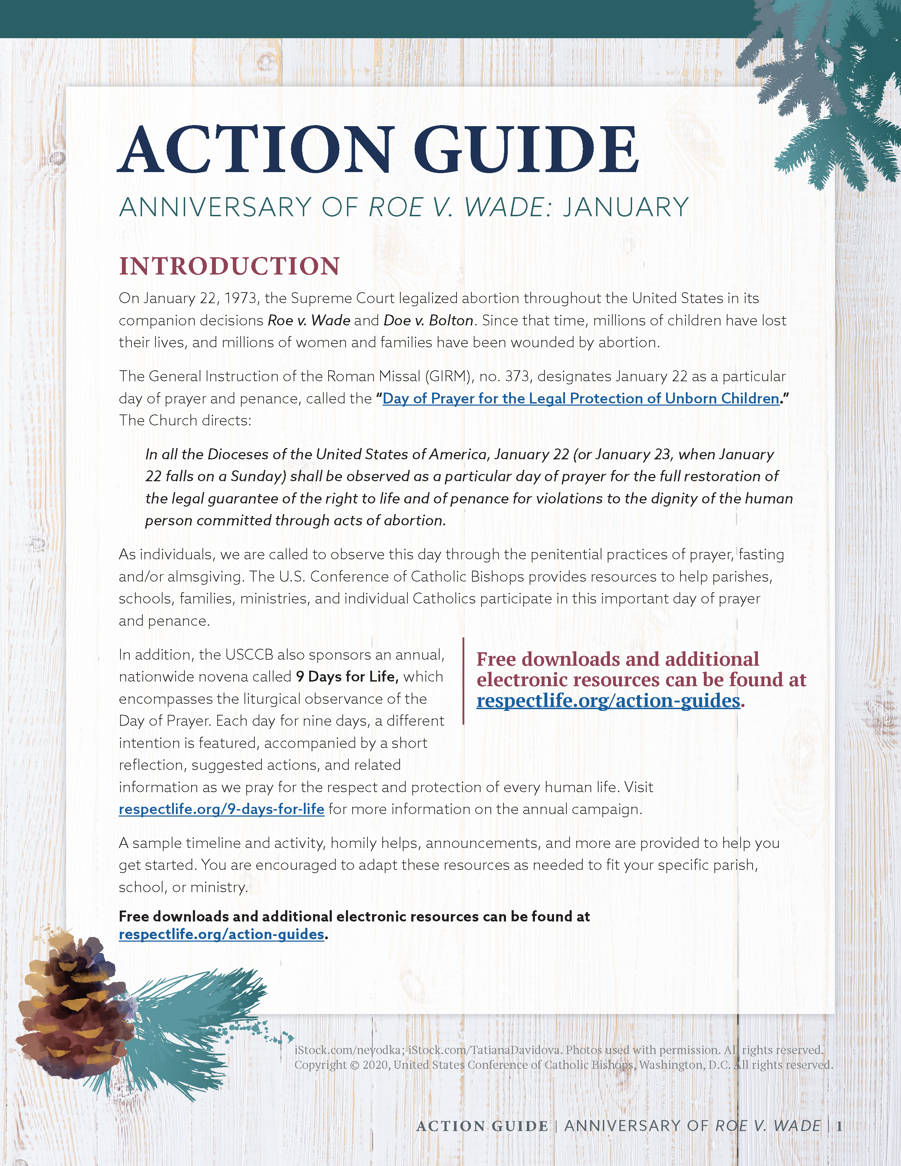
Parish Action Guides
January: Anniversary of Roe v. Wade
March 25: Annunciation of the Lord
April: Sunday of Divine Mercy
May: Mother’s Day
Father’s Day
October: Respect Life Month
www.respectlife.org/action-guides

Slide 8
Parish Action Guide: Components
Introduction
Simple Steps
Sample Timeline
Bulletin & Pulpit Announcements
Intercessions
Homily Helps
Sample Activity
www.respectlife.org/action-guides

Slide 9
Parish Action Guide: Introduction
What is this occasion?
How is it connected to the gift of human life?
What’s provided?

Slide 10
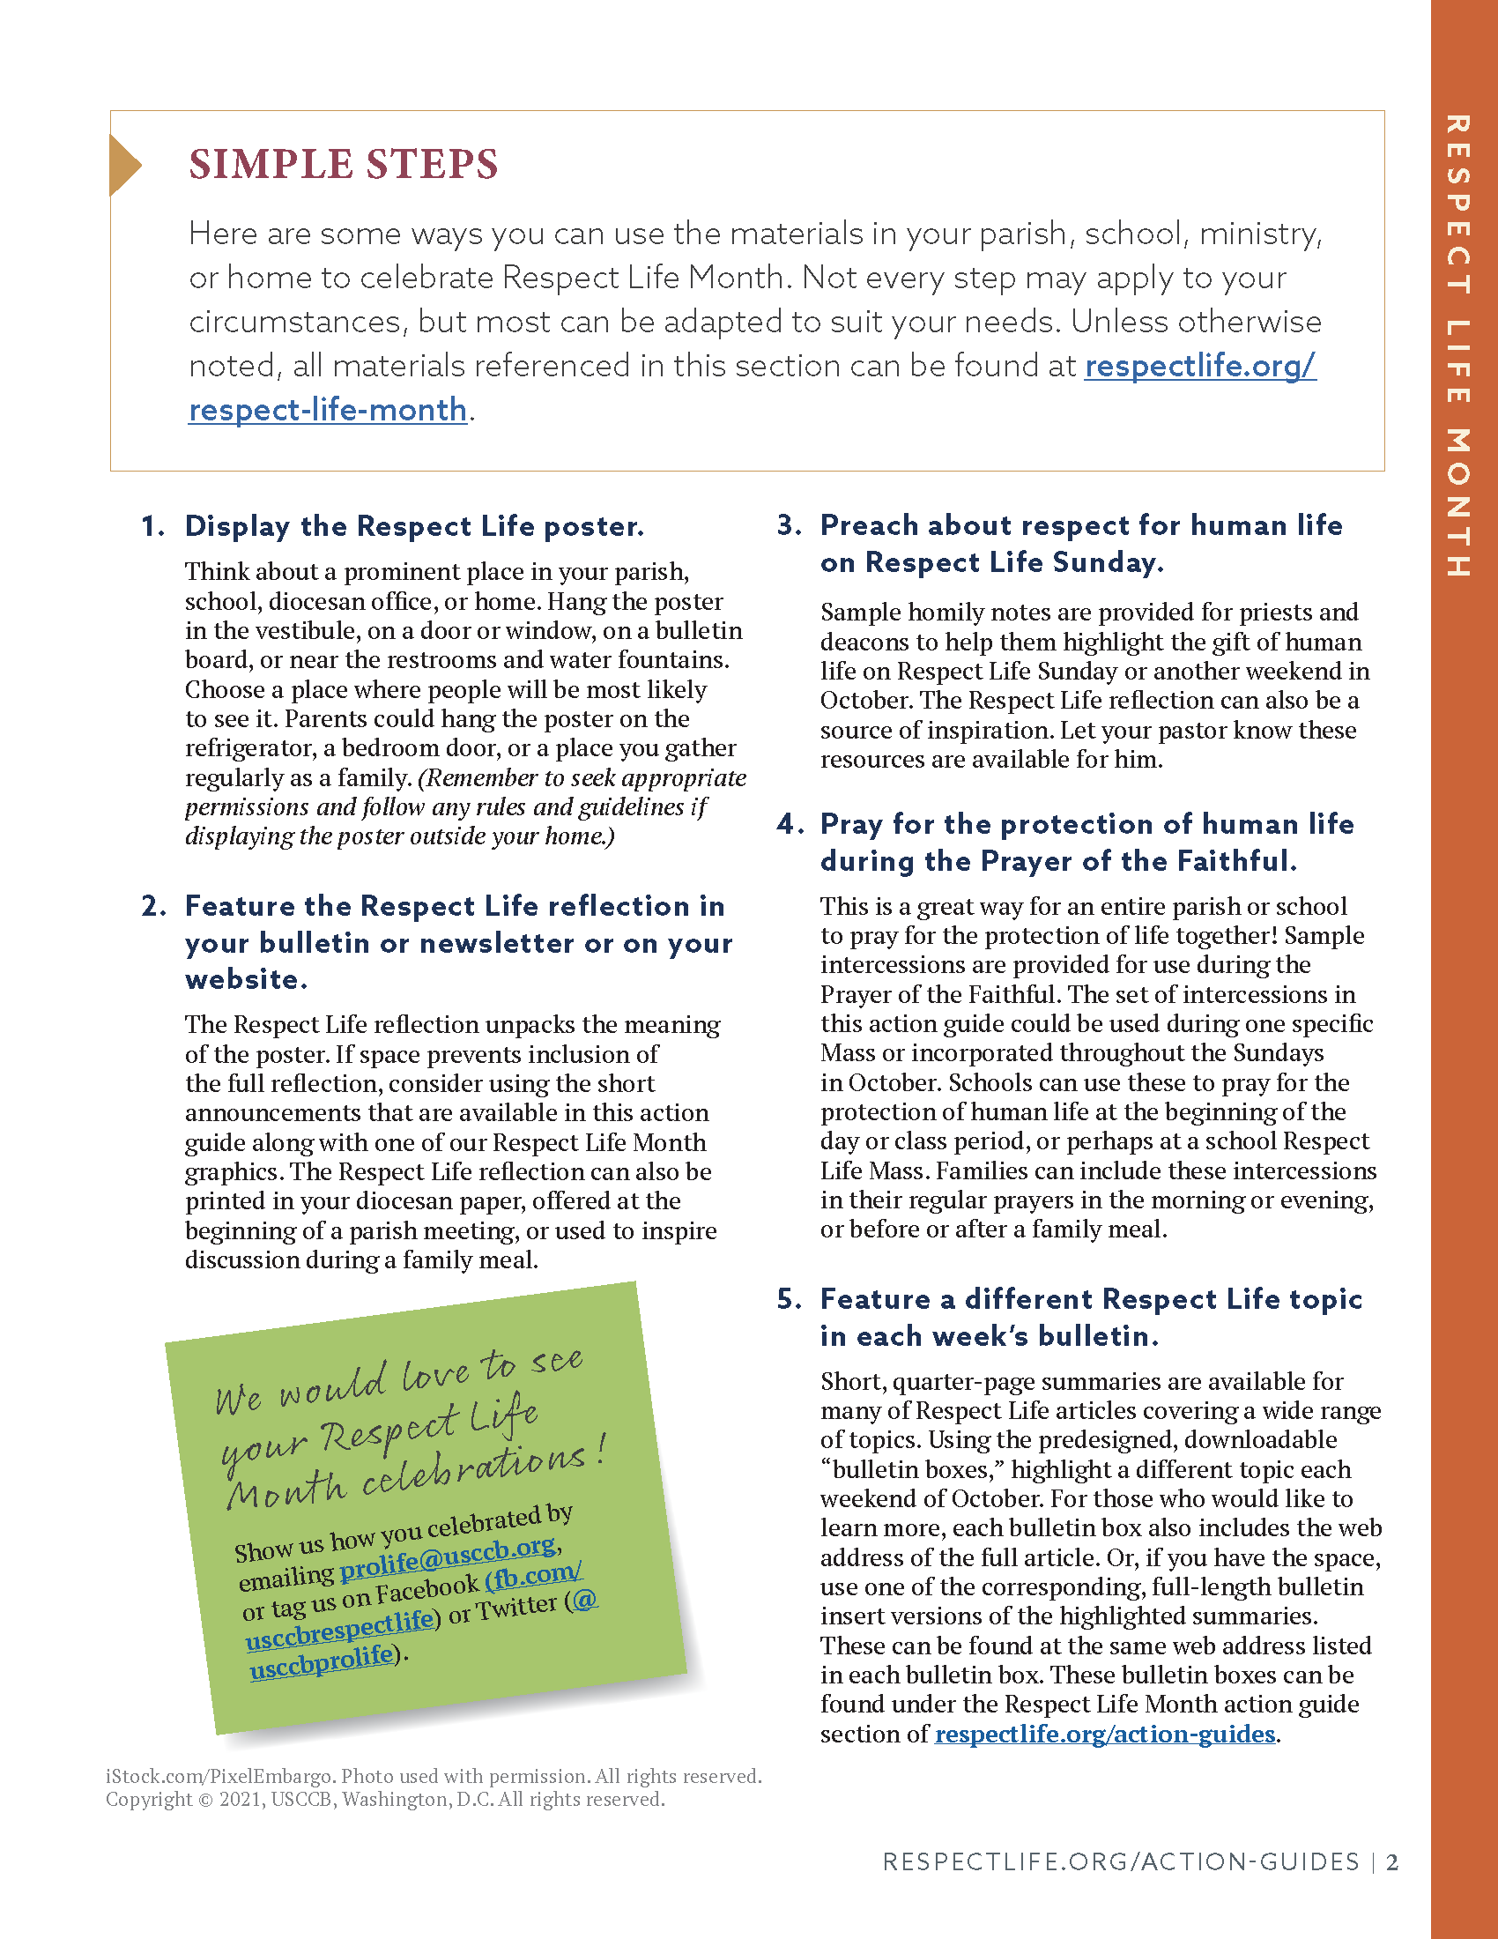
Parish Action Guide: Simple Steps
Display poster.
Reflect.
Preach on Respect Life Sunday.
Pray for for the protection of human life.
Educate.

Slide 11
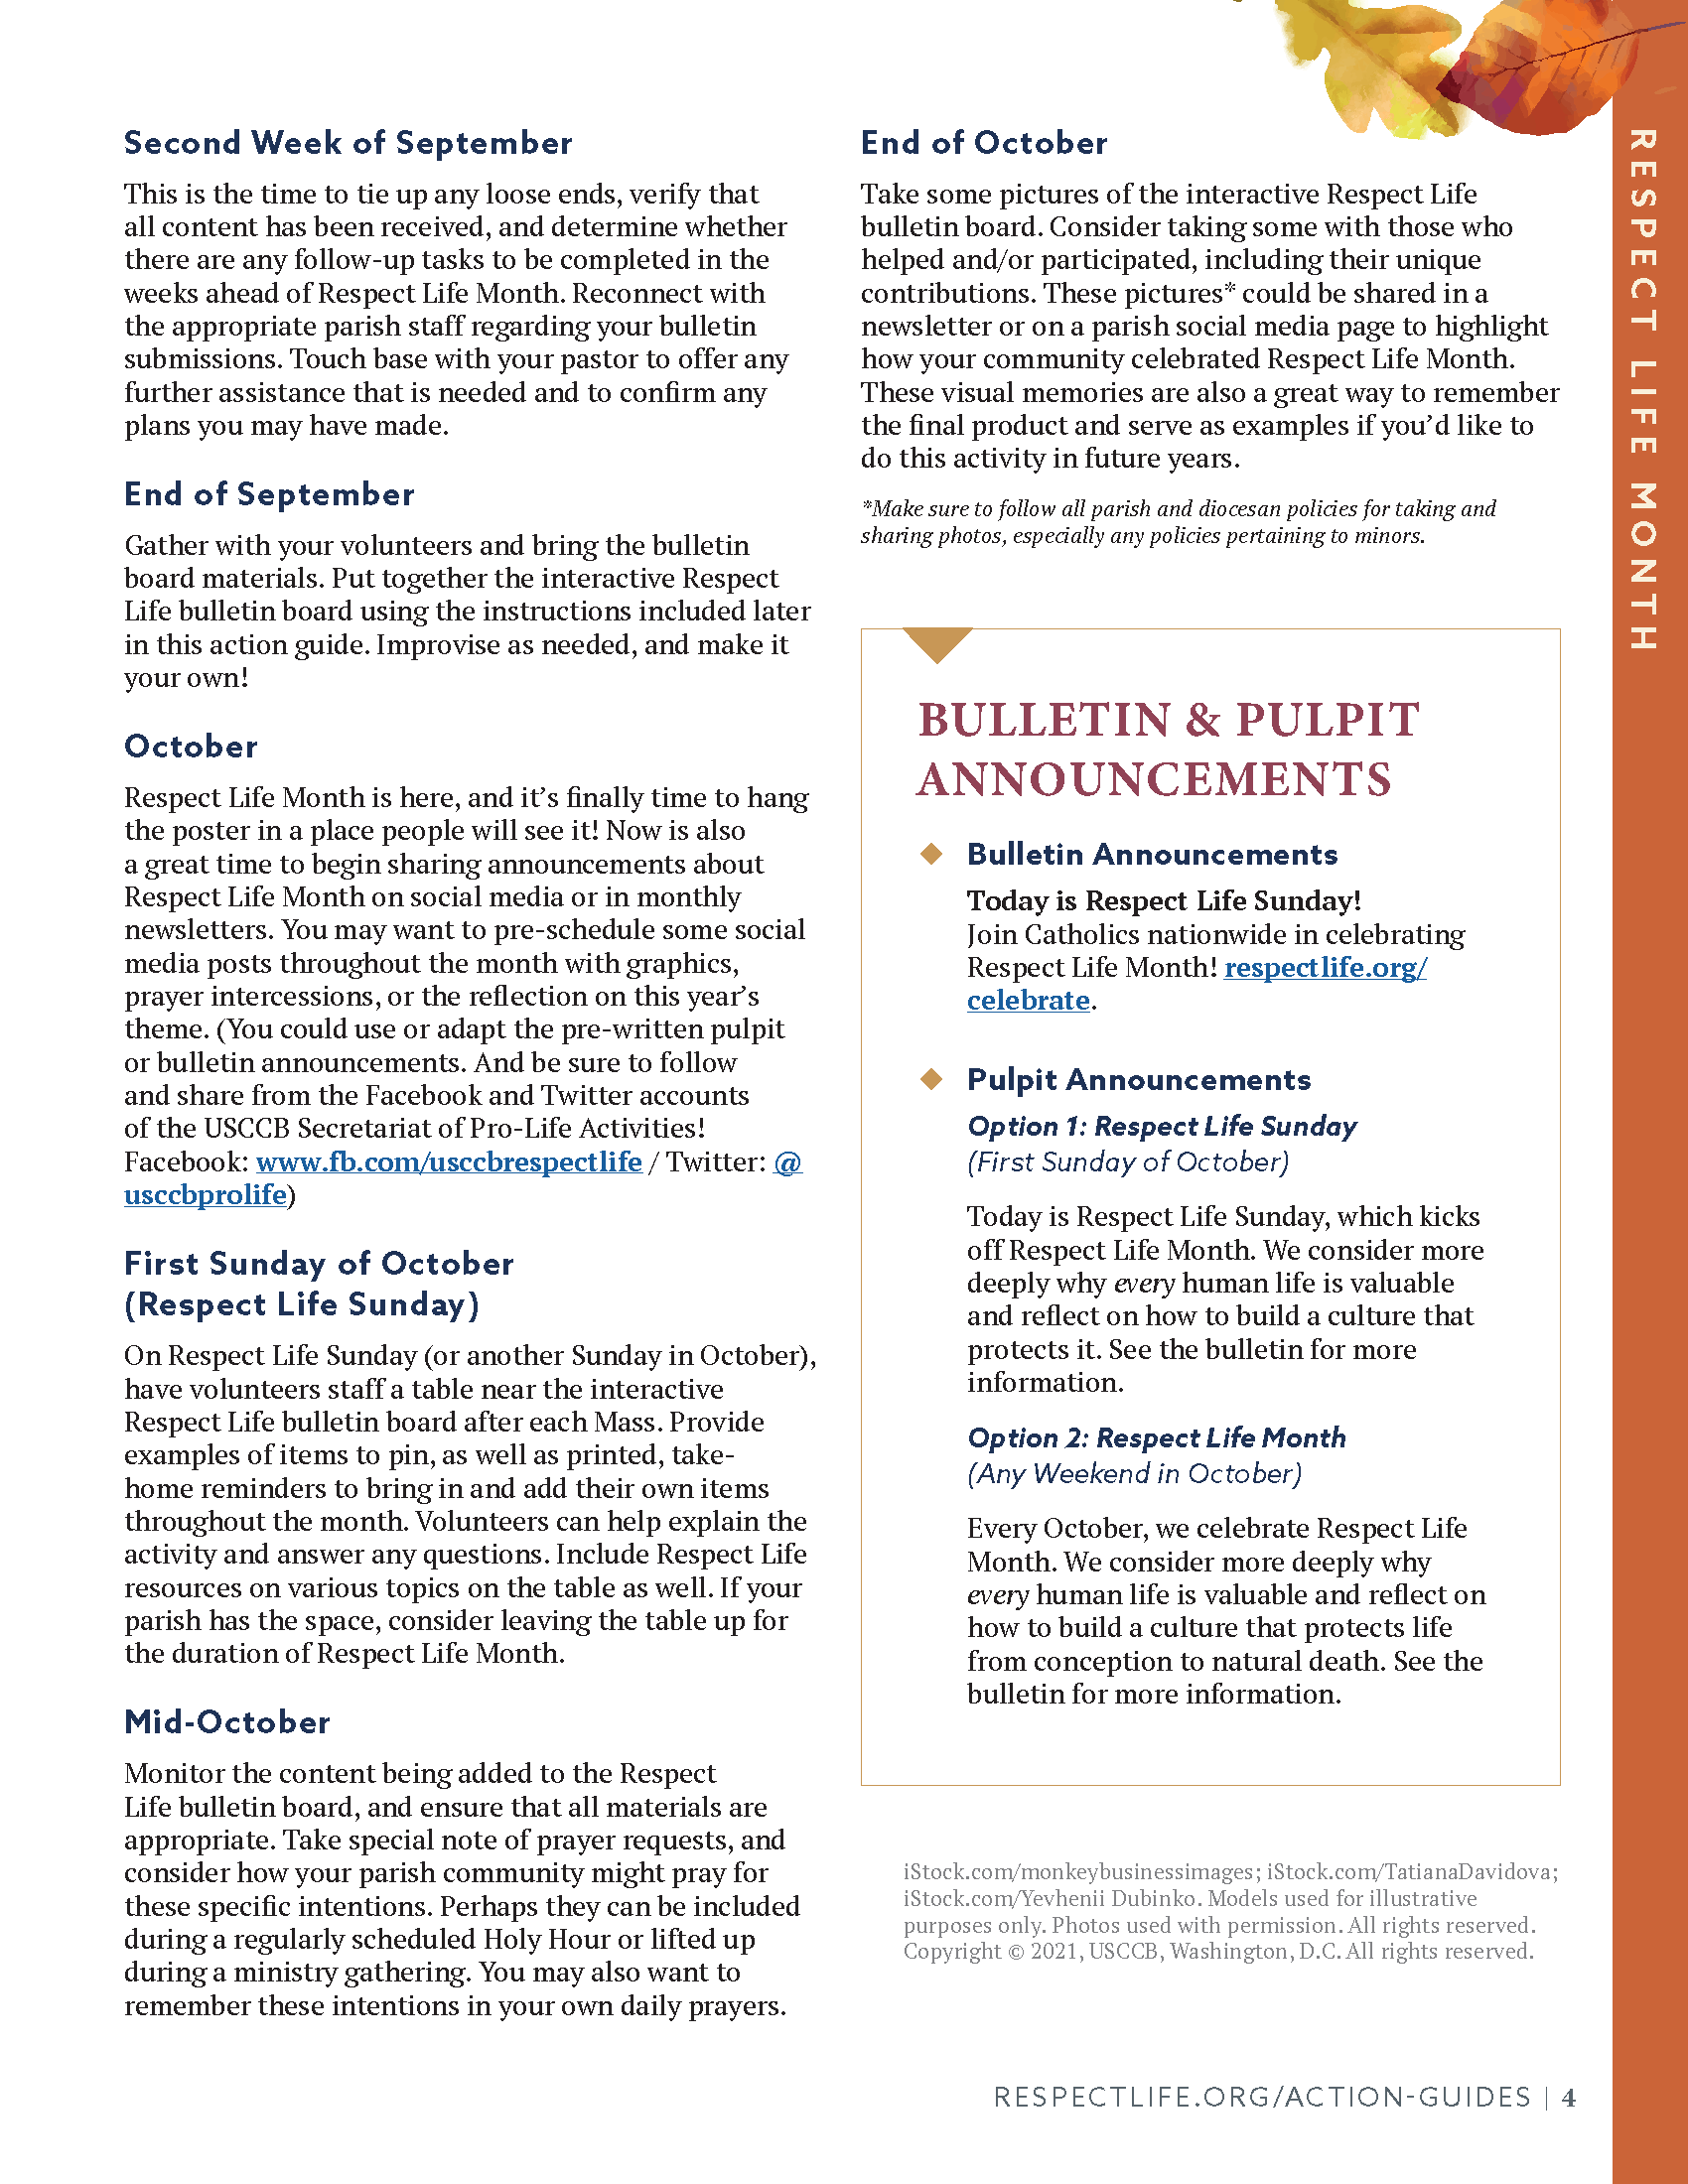
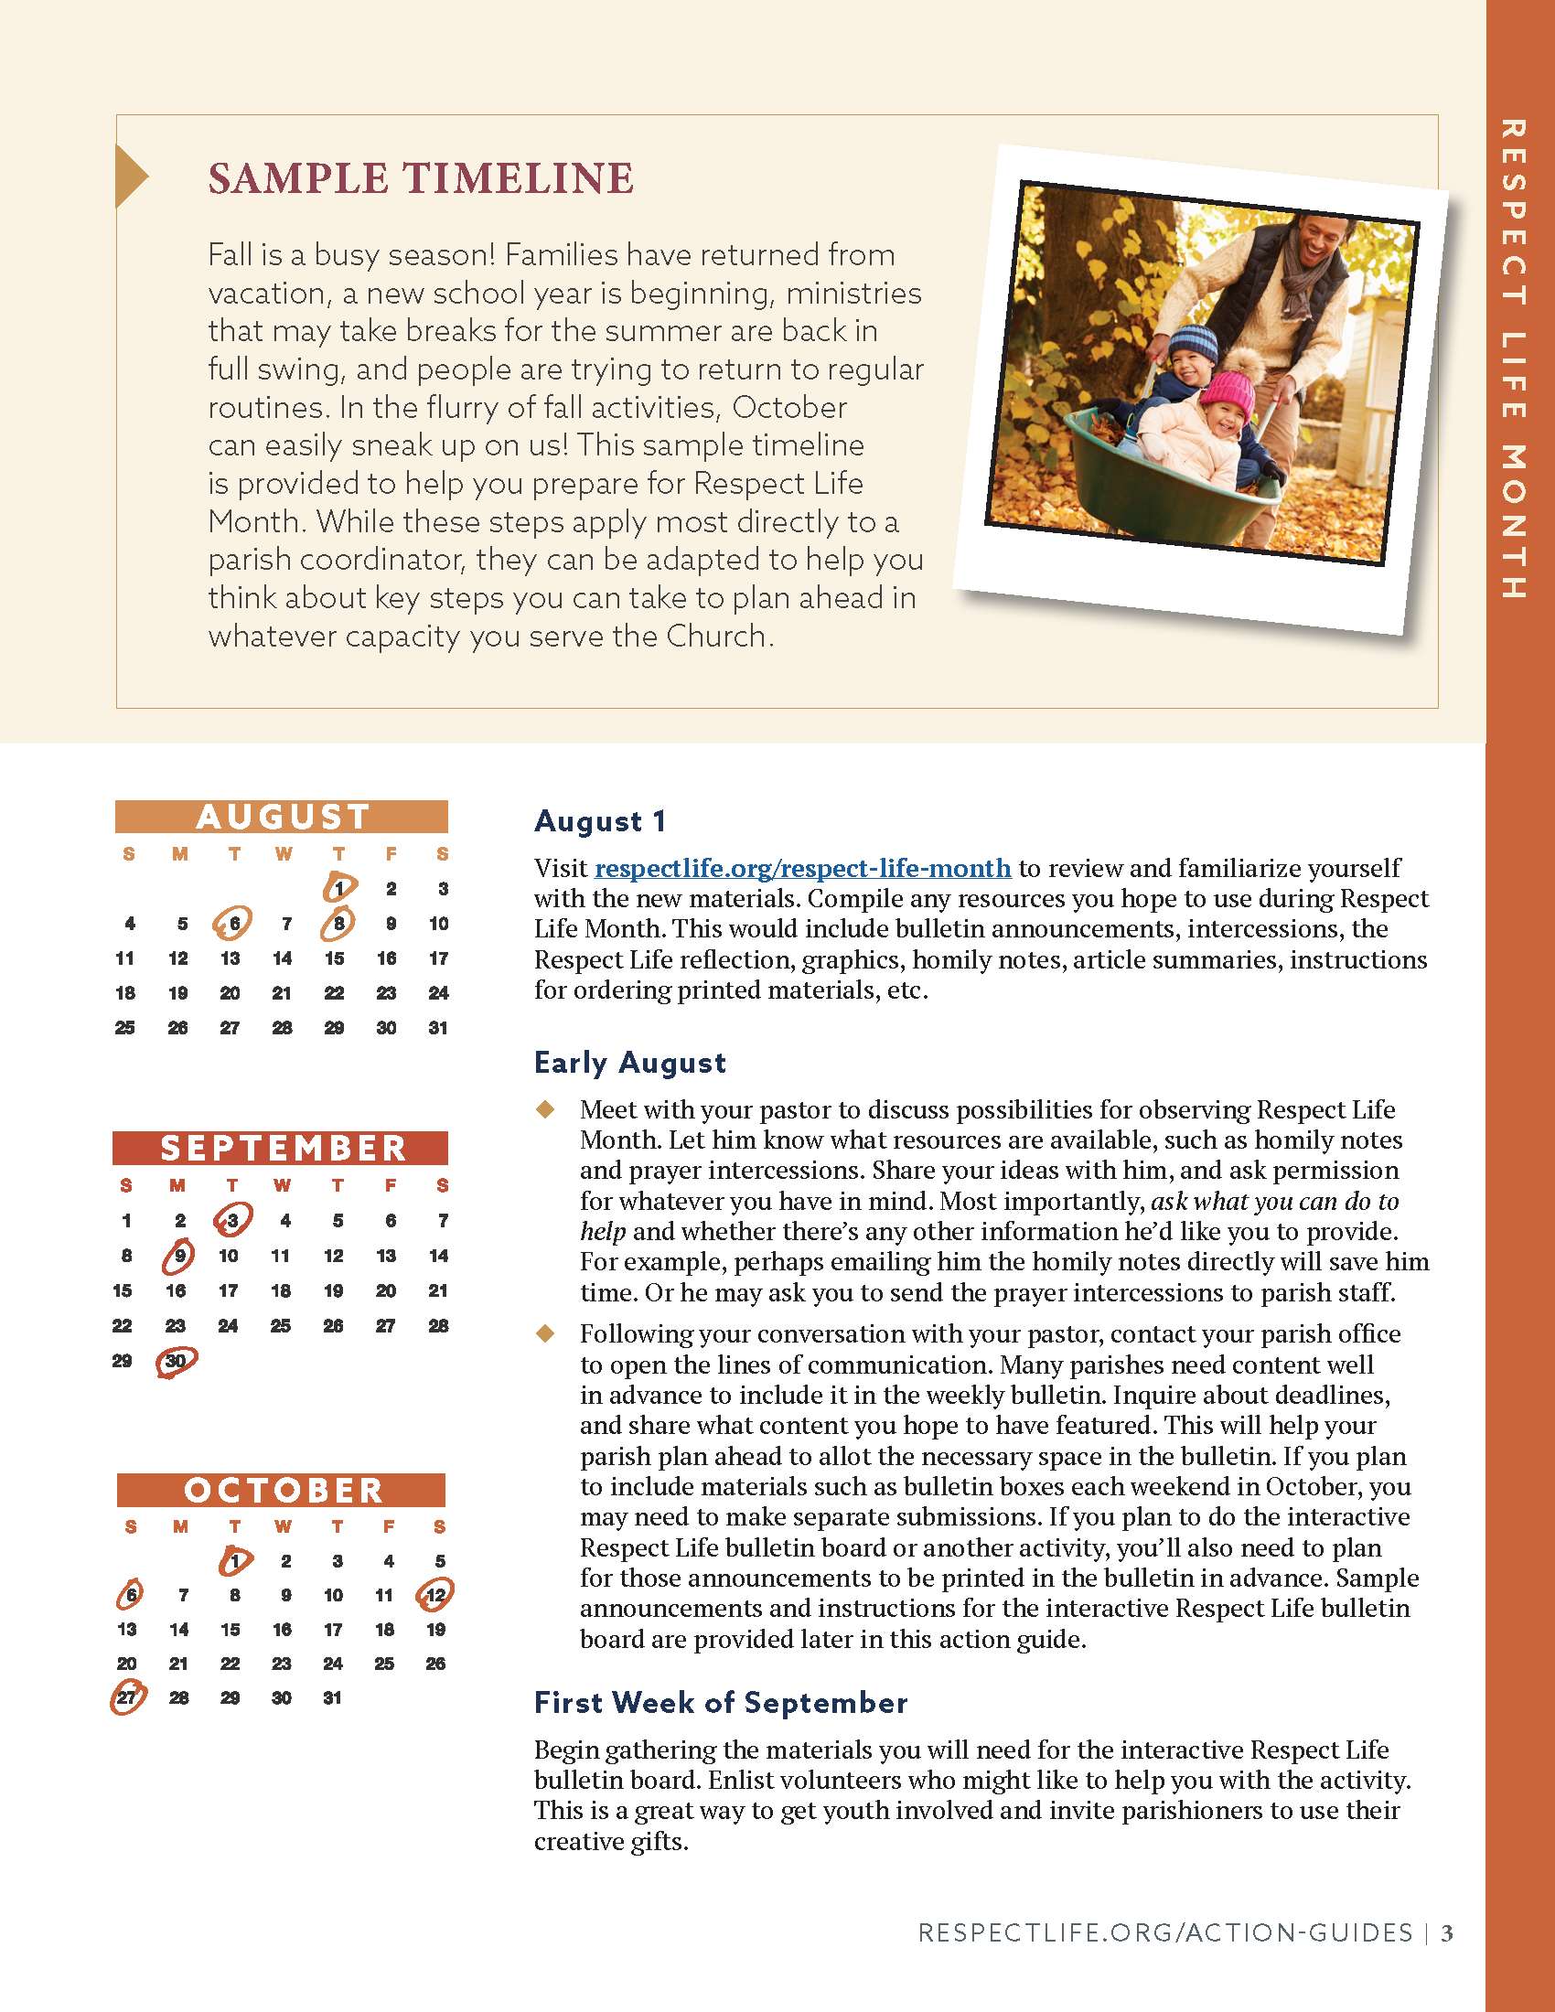
Parish Action Guide: Sample Timeline
Connect with your pastor and parish staff.
Research and gather materials.
Recruit volunteers.
Submit bulletin & pulpit announcements.
Tie up any loose ends and make sure everyone has what they need.
Set up.

Slide 12
Parish Action Guide: Sample Timeline
Facilitate the activity.
Monitor the activity.
Take pictures.
Clean up.
Follow up (express thanks, take notes, share with the community).

Slide 13
Parish Action Guide: Announcements
Suggested dates provided
Simple ideas for observing Respect Life Month

Slide 14
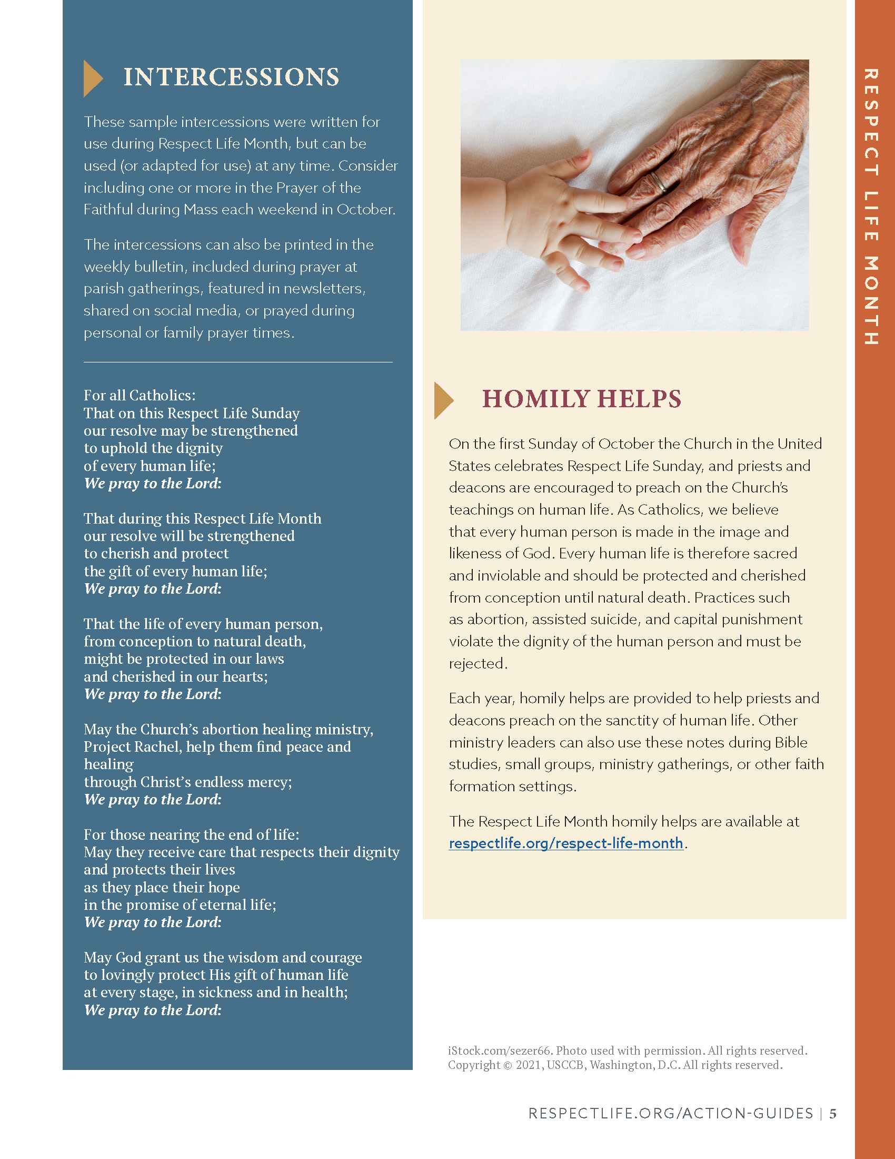
Parish Action Guide: Intercessions
Prayer of the Faithful
Bulletin
Parish communications
Family prayer
Religion class

Slide 15
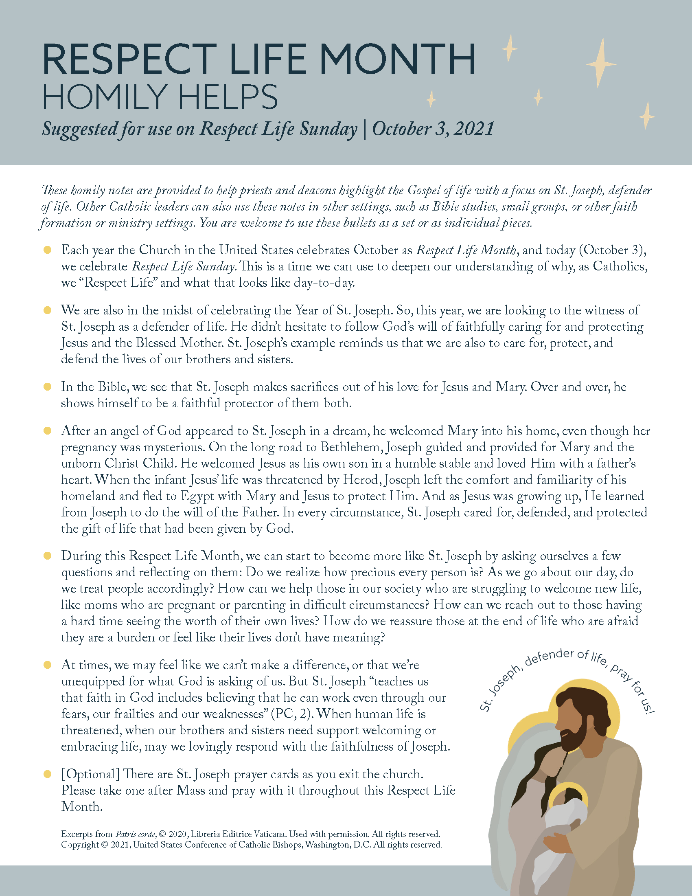
Parish Action Guide: Homily Helps
St. Joseph’s example
Use in entirety or piecemeal
Other settings (Bible studies, small groups, talks)

Slide 16
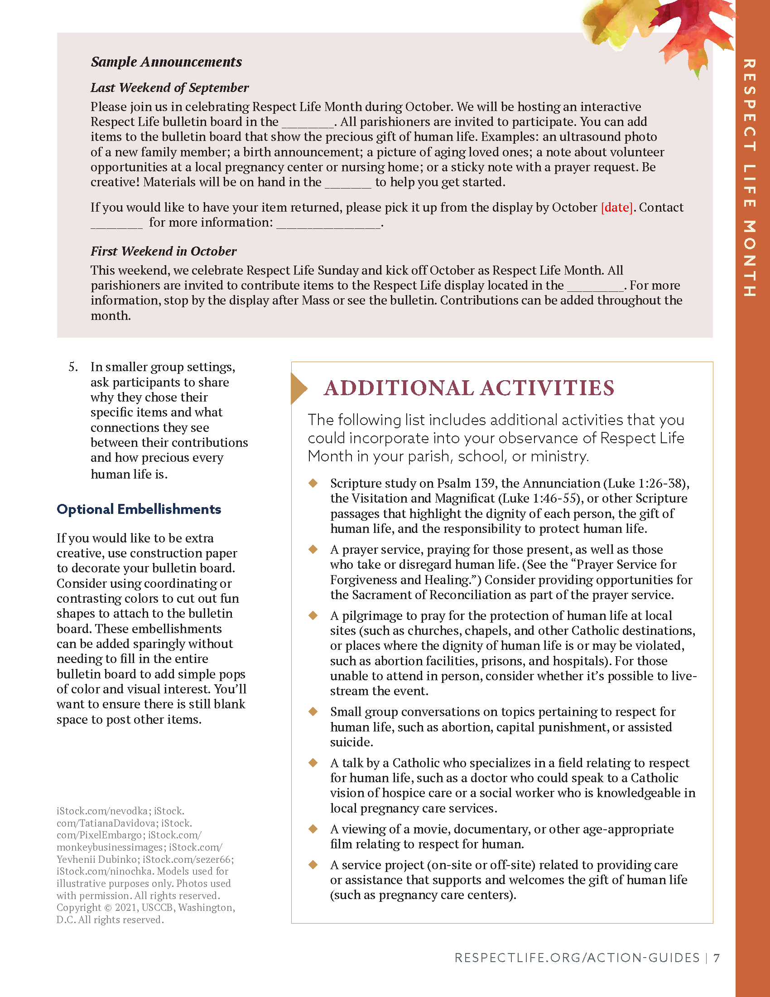
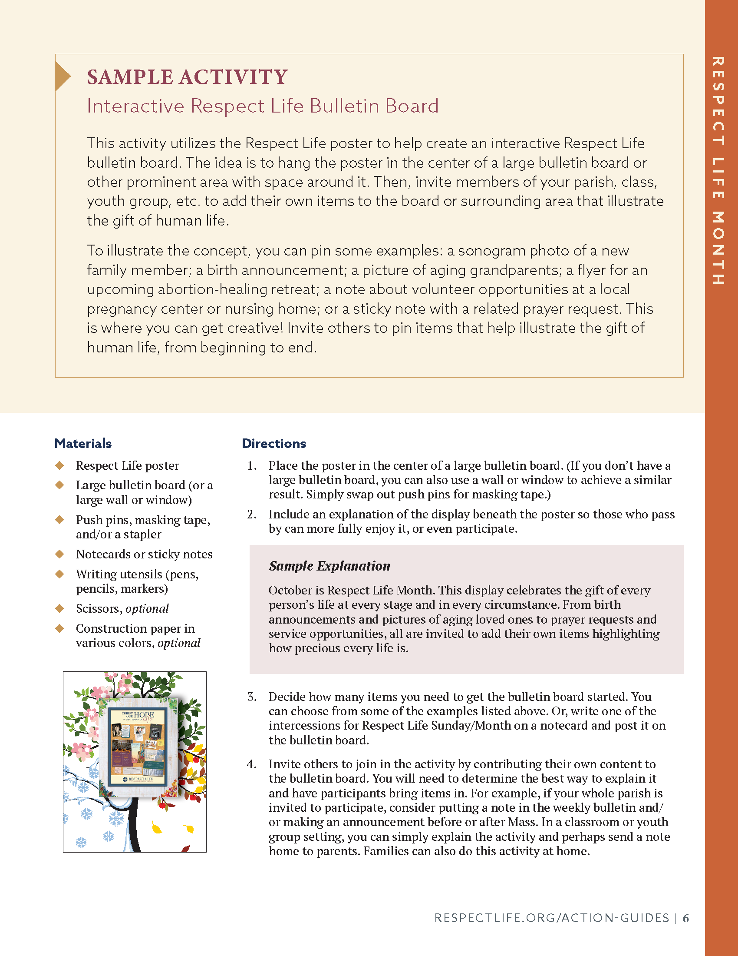
Parish Action Guide: Sample Activity
Interactive Bulletin Board
Materials
Directions
At-Home Modification

Slide 17
Next Steps…
REVIEW the available resources.
DECIDE what you would like to ask permission to implement.
CONNECT with your pastor and parish staff.
…And remember, progress, not perfection.

